Slide 1
A Hands-On Introduction to GraphBLAS: The Python Edition http://graphblas.org
≡
Scott McMillan
CMU/SEI
Tim Mattson
Intel Labs
… and the other members of the GraphBLAS specification group: Aydın Buluç (UC Berkeley/LBNL), Jose Moreira (IBM), and Ben Brock (UC Berkeley).
With a special thank you to Tim Davis (Texas A&M) for GraphBLAS support in SuiteSparse and Michel Pelletier (Graphegon) for creating pygraphblas.
To get course materials onto your laptop:
$ git clone https://github.com/GraphBLAS-Tutorials/ICS21-Tutorial.git

Slide 2
Copyright 2021 Carnegie Mellon University and Timothy G. Mattson.
This material is based upon work funded and supported by the Department of Defense under Contract No. FA8702-15-D-0002 with Carnegie Mellon University for the operation of the Software Engineering Institute, a federally funded research and development center.
The view, opinions, and/or findings contained in this material are those of the author(s) and should not be construed as an official Government position, policy, or decision, unless designated by other documentation.
References herein to any specific commercial product, process, or service by trade name, trade mark, manufacturer, or otherwise, does not necessarily constitute or imply its endorsement, recommendation, or favoring by Carnegie Mellon University or its Software Engineering Institute.
NO WARRANTY. THIS CARNEGIE MELLON UNIVERSITY AND SOFTWARE ENGINEERING INSTITUTE MATERIAL IS FURNISHED ON AN "AS-IS" BASIS. CARNEGIE MELLON UNIVERSITY MAKES NO WARRANTIES OF ANY KIND, EITHER EXPRESSED OR IMPLIED, AS TO ANY MATTER INCLUDING, BUT NOT LIMITED TO, WARRANTY OF FITNESS FOR PURPOSE OR MERCHANTABILITY, EXCLUSIVITY, OR RESULTS OBTAINED FROM USE OF THE MATERIAL. CARNEGIE MELLON UNIVERSITY DOES NOT MAKE ANY WARRANTY OF ANY KIND WITH RESPECT TO FREEDOM FROM PATENT, TRADEMARK, OR COPYRIGHT INFRINGEMENT.
[DISTRIBUTION STATEMENT A] This material has been approved for public release and unlimited distribution. Please see Copyright notice for non-US Government use and distribution.
This material may be reproduced in its entirety, without modification, and freely distributed in written or electronic form without requesting formal permission. Permission is required for any other use. Requests for permission should be directed to the Software Engineering Institute at permission@sei.cmu.edu.
DM21-0192

Slide 3
Outline
Graphs and Linear Algebra
The GraphBLAS API and Adjacency Matrices
GraphBLAS Operations
Pygraphblas and modifying the behavior of operations.
Graph Algorithms expressed with GraphBLAS
Breadth-First Traversal
Connected Components
Triangle Counting
PageRank

Slide 4
Schedule
What we cover in any given session depends on how fast you all move through the content.
EDT (UTC-4) | PDT (UTC-7)
9:30 to 11:00 | 6:30 to 8:00 | Session 1
11:00 to 11:30 | 8:00 to 8:30 | break
11:30 to 1:00 | 8:30 to 10:00 | Session 2
1:00 to 2:00 | 10:00 to 11:00 | lunch
2:00 to 3:30 | 11:00 to 12:30 | Session 3
3:30 to 4:00 | 12:30 to 1:00 | break
4:00 to 5:30 | 1:00 to 2:30 | Session 4
https://graphblas-tutorials.github.io/ICS21-Tutorial/

Slide 5
Outline
Graphs and Linear Algebra
The GraphBLAS API and Adjacency Matrices
GraphBLAS Operations
Pygraphblas and modifying the behavior of operations.
Graph Algorithms expressed with GraphBLAS
Breadth-First Traversal
Connected Components
Triangle Counting
PageRank

Slide 6
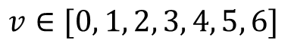
Understanding relationships between items
Graph: A visual representation of a set of vertices and the connections between them (edges).
0
1
6
3
4
2
5
Graph: Two sets, one for the vertices ($v$) and one for the edges ($e$)
$$v∈[0, 1, 2, 3, 4, 5, 6]$$
$$e∈[\left(0,1\right), \left(0,3\right), \left(1,4\right), \left(1,6\right), \left(2,5\right),\left(3,0\right),\left(3,2\right), \left(4,5\right), \left(5,2\right), \left(6,2\right), \left(6,3\right), (6,4)]$$

Slide 7
A graph as a matrix
Adjacency Matrix: A square matrix (usually sparse) where rows and columns are labeled by vertices and non-empty values are edges from a row vertex to a column vertex
To vertex (columns)
0
1
- | ★ | - | ★ | - | - | -
- | - | - | - | ★ | - | ★
- | - | - | - | - | ★ | -
★ | - | ★ | - | - | - | -
- | - | - | - | - | ★ | -
- | - | ★ | - | - | - | -
- | - | ★ | ★ | ★ | - | -
6
3
4
A =
From vertex (rows)
2
5
By using a matrix, I can turn algorithms working with graphs into linear algebra.
Notes:
You can turn them into semi-ring algebra.
Tim answers … No, its linear algebra. The semi-ring is the algebraic structure used when defining the domain and operations in the linear vector space.

Slide 8
A Directed graph as a matrix
Adjacency Matrix: A square matrix (usually sparse) where rows and columns are labeled by vertices and non-empty values are edges from a row vertex to a column vertex
To vertex (columns)
0
1
- | ★ | - | ★ | - | - | -
- | - | - | - | ★ | - | ★
- | - | - | - | - | ★ | -
★ | - | ★ | - | - | - | -
- | - | - | - | - | ★ | -
- | - | ★ | - | - | - | -
- | - | ★ | ★ | ★ | - | -
6
3
4
A =
From vertex (rows)
2
5
This is a directed graph (the edges have arrows)
Notes:
You can turn them into semi-ring algebra.
Tim answers … No, its linear algebra. The semi-ring is the algebraic structure used when defining the domain and operations in the linear vector space.

Slide 9
An Undirected graph as a matrix
Adjacency Matrix: A square matrix (usually sparse) where rows and columns are labeled by vertices and non-empty values are edges from a row vertex to a column vertex
To vertex (columns)
0
1
- | ★ | - | ★ | - | - | -
★ | - | - | - | ★ | - | ★
- | - | - | ★ | - | ★ | ★
★ | - | ★ | - | - | - | ★
- | ★ | - | - | - | ★ | ★
- | - | ★ | - | ★ | - | -
- | ★ | ★ | ★ | ★ | - | -
6
3
4
A =
From vertex (rows)
2
5
This is an undirected graph (no arrows on the edges) and the Adjacency matrix is symmetric
Notes:
You can turn them into semi-ring algebra.
Tim answers … No, its linear algebra. The semi-ring is the algebraic structure used when defining the domain and operations in the linear vector space.

Slide 10
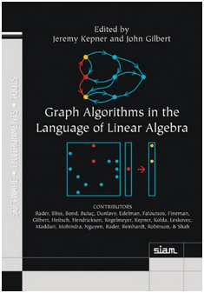
Graph Algorithms and Linear Algebra
Most common graph algorithms can be represented in terms of linear algebra.
This is a mature field … it even has a book.
Benefits of graphs as linear algebra
Well suited to memory hierarchies of modern microprocessors
Can utilize decades of experience in distributed/parallel computing from linear algebra in supercomputing.
Easier to understand … for some people.

Slide 11
How do linear algebra people write software?
They do so in terms of the BLAS:
The Basic Linear Algebra Subprograms: low-level building blocks from which any linear algebra algorithm can be written
BLAS 1 | Vector/vector | Lawson, Hanson, Kincaid and Krogh, 1979 | LINPACK
BLAS 2 | Matrix/vector | Dongarra, Du Croz, Hammarling and Hanson, 1988 | LINPACK on vector machines
BLAS 3 | Matrix/matrix | Dongarra, Du Croz, Hammarling and Hanson, 1990 | LAPACK on cache-based machines
The BLAS supports a separation of concerns:
HW/SW optimization experts tuned the BLAS for specific platforms.
Linear algebra experts build software on top of the BLAS ... high performance “for free”.
It is difficult to over-state the impact of the BLAS … they revolutionized the practice of computational linear algebra.

Slide 12
GraphBLAS: building blocks for graphs as linear algebra
Basic objects
Matrix, vector, algebraic structures, and ”control objects”
Fundamental operations over these objects
Element-wise operations (eWiseAdd, eWiseMult)
Matrix multiplication
Matrix-vector multiplication
(vxm, mxv)
Extract (and Assign) submatrices
…plus reductions, transpose, and application of a function to each element of a matrix or vector

Slide 13
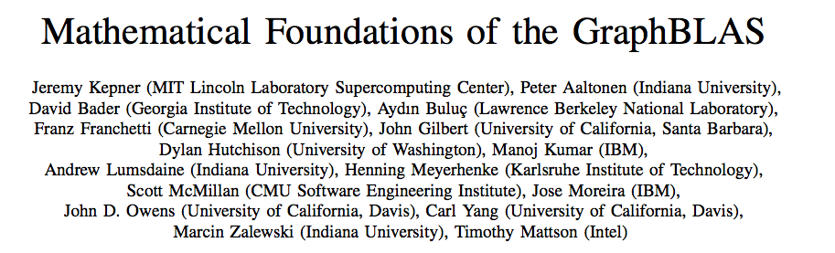
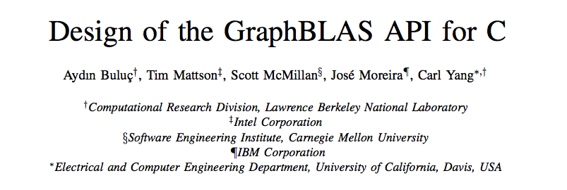
GraphBLAS References
IEEE HPEC 2016
GABB@IPDPS 2017
The official GraphBLAS C spec can be found at: www.graphblas.org

Slide 14
GraphBLAS Implementations
SuiteSparse library (Texas A&M): First fully conforming GraphBLAS release.
http://faculty.cse.tamu.edu/davis/suitesparse.html
GraphBLAS C (IBM): the second fully conforming release,
https://github.com/IBM/ibmgraphblas
GBTL: GraphBLAS Template Library (CMU/PNNL): Pushing GraphBLAS into C++
https://github.com/cmu-sei/gbtl
GraphBLAST: A C++ implementation for GraphBLAS for GPUs (UC Davis),
https://github.com/gunrock/graphblast
Python bindings:
pygraphblas: A Python Wrapper around SuiteSparse GraphBLAS
https://github.com/Graphegon/pygraphblas
grblas: Python wrapper around GraphBLAS (part of Anaconda’s MetaGraph work)
https://github.com/metagraph-dev/grblas
pyGB: A Python Wrapper around GBTL (UW/PNNL/CMU)
https://github.com/jessecoleman/gbtl-python-binding
pgGraphBLAS: A PostgreSQL wrapper around Suite Sparse GraphBLAS
https://github.com/michelp/pggraphblas
Matlab and Julia wrappers around SuiteSparse GraphBLAS
https://aldenmath.com
Third Party names are the property of their owners

Slide 15
The GraphBLAS Vision
LAGraph

Slide 16
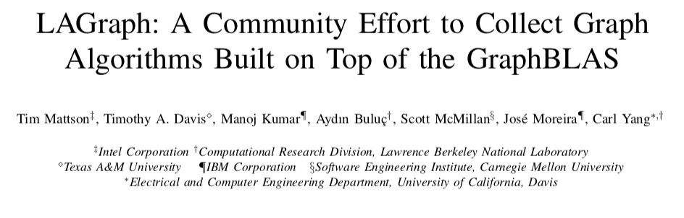
LAGraph: A curated collection of high level Graph Algorithms
Graph Algorithms built on top of the GraphBLAS.
GrAPL 2019
Official release of LAGraph library v1.0 later in 2021

Slide 17
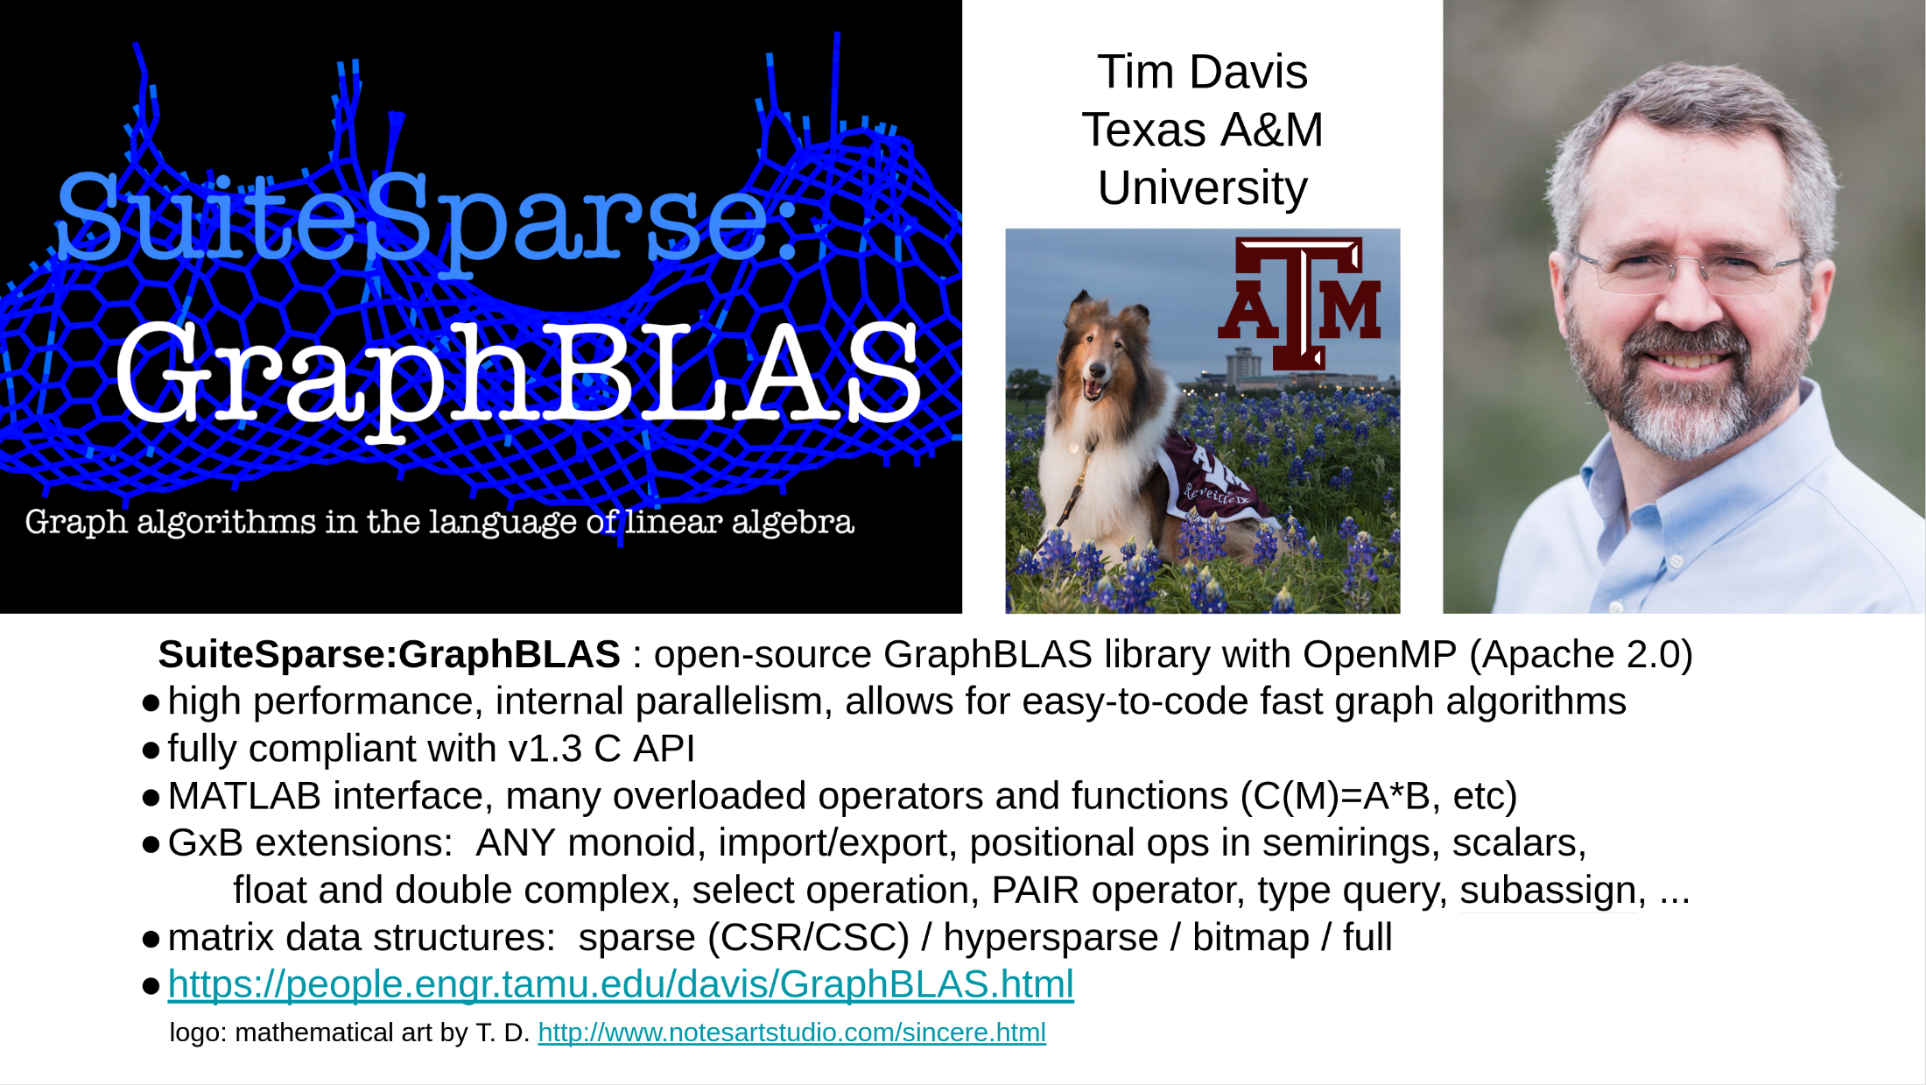
SuiteSparse: C libraries for GraphBLAS and LAGraph

Slide 18
Pygraphblas Documentation at: https://graphegon.github.io/pygraphblas/pygraphblas/index.html

Slide 19


Your personalized container powered by
“You log into the cloud by ssh and magic happens that causes little people floating in the cloud to create an account for you that runs on fairy dust and makes a container float up from the ether to respond to your every whim.”
[Distribution Statement A] Approved for public release and unlimited distribution.
Notes:
IBM Cloud has graciously provided us with cloud resources for this tutorial. Each of you will have an individual Jupyter Notebook that you can use for the duration of this tutorial, both today and tomorrow. To create your notebook, you will SSH into the host `graphblas.tk` with the username `user` and password `graphblastutorial2021`. This will boot up a Docker container with a Jupyter Notebook for you to use. Be sure to save the URL printed out, as you will need it for both days of the tutorial.
As for the actual technical details of how this happens: when you SSH in, it will call Docker to create a new Docker container running Jupyter Notebook and print out its URL. I just modified it so that the containers will be persistent, so there should be no need to save the state between days. (However, they'll probably need to save anything that's important at the end of the second day, since we'll be powering down our IBM Cloud time sometime after the tutorial ends.)
Ben

Slide 20
GraphBLAS in the cloud: Setting up your session
SSH into the host `graphblas.tk` with the username `user` and password `graphblastutorial2021`.
$ ssh user@graphblas.tk
user@graphblas.tk's password:
You should see output similar to the following:
[I 21:42:32.806 NotebookApp] Writing notebook server cookie secret to /home/jovyan/.local/share/jupyter/runtime/notebook_cookie_secret
[I 21:42:33.440 NotebookApp] JupyterLab extension loaded from /opt/conda/lib/python3.8/site-packages/jupyterlab
[I 21:42:33.440 NotebookApp] JupyterLab application directory is /opt/conda/share/jupyter/lab
[I 21:42:33.443 NotebookApp] Serving notebooks from local directory: /home/jovyan/ICS21-Tutorial
[I 21:42:33.443 NotebookApp] Jupyter Notebook 6.1.6 is running at:
...
Your Docker container should now be ready at:
=====
http://graphblas.tk:98765/?token=1234567890abcdef1234567890abcdef1234567890abcdef
=====
****SAVE THIS URL!**** You will also need it for Day 2 of the tutorial.
If you do not see a URL, or there otherwise appears to be an error, please alert the tutorial staff.
Connection to graphblas.tk closed.
To access the notebook, open this file in a browser (Chrome or Firefox recommended):
file:///home/jovyan/.local/share/jupyter/runtime/nbserver-7-open.html
Or copy and paste the graphblas.tk URL (above) into your browser. This will open up a Jupyter Notebook running inside a Docker container created just for you in the IBM cloud.
Bookmark or save your URL. You can reconnect to same instance throughout class.
Notes:
We need to make sure that Ben changes the scripts to not kill the instance between days. Or we should show them how to download their notebooks at the end of the day 1 and upload them to start day 2.

Slide 21
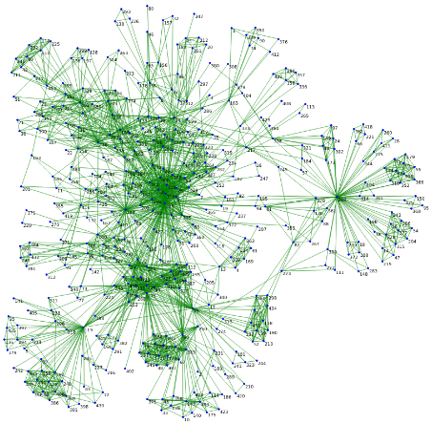
Exercise 1: Running a GraphBLAS program
Launch the GraphBLAS container in the cloud
$ ssh user@graphblas.tk
It will ask for a password
graphblastutorial2021
Cut-and-paste the returned URL in your browser (Save this URL so you can reconnect to the container later).
Launch the AnalyzeGraph notebook and run-all from the cells menu to find the “2-hop” neighborhood of one author in the HPEC papers graph and then perform PageRank and draw a visualization of this reduced neighborhood [this visualization could take a while to render].
If all goes well, we will have confirmed that everything is working … that you have container you can access through Jupyter notebook.
Notes:
The first program should load a larger graph (real data) and perform a few statistics on them like average degree, num_nodes, num_edges

Slide 22
HPEC Authors Dataset
Data represents all pairs of HPEC* authors that have coauthored papers. The edge value represents how many papers the pair have coauthored.
Graph (undirected):
1,747 vertices (unique authors)
10,072 edges (coauthor count)
Data directory contains index tables containing the mapping between vertex ID and author name, the raw publication data, and python scripts to perform various queries
*HPEC: IEEE High Performance Extreme Computing Conference. A conference held each September in Waltham MA where many Graph People gather each year.
Notes:
Connected components: a subgraph of vertices connected to each other by a path, but not to vertices outside the subgraph

Slide 23
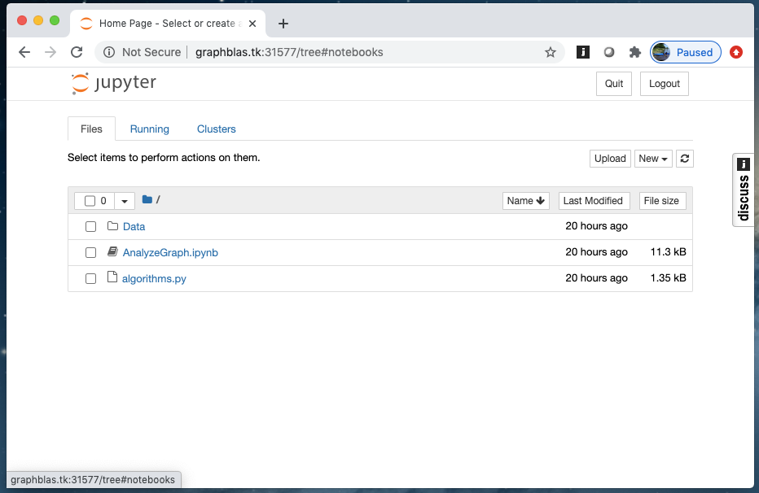
The jupyter session exposed by the container

Slide 24
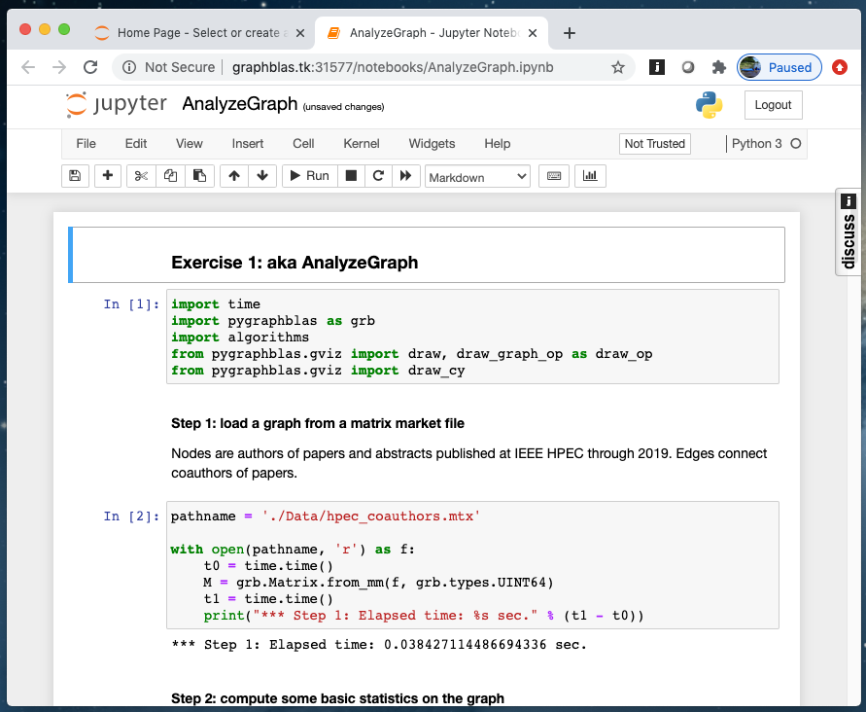
The AnalyzeGraph Notebook

Slide 25
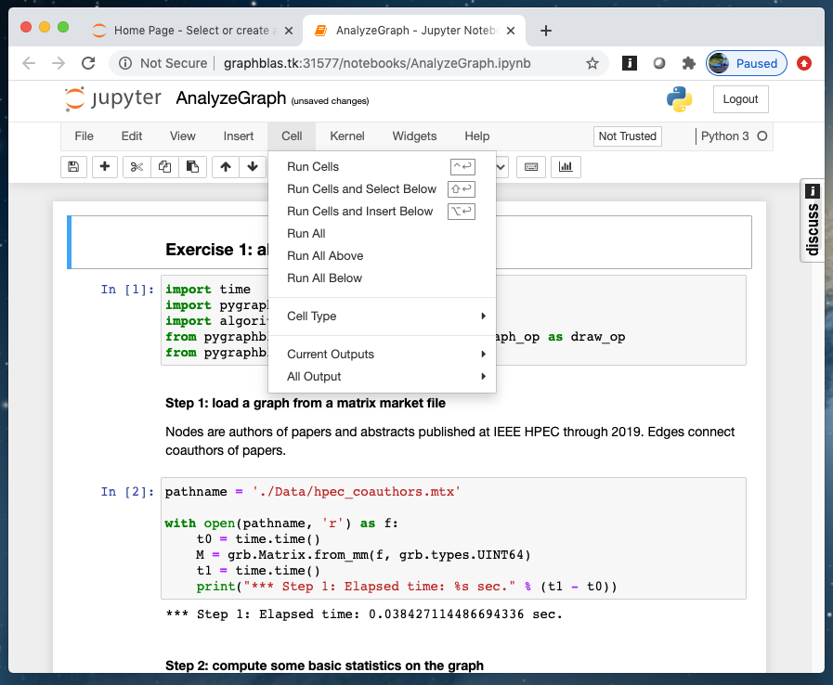
Run all the cells in the notebook

Slide 26
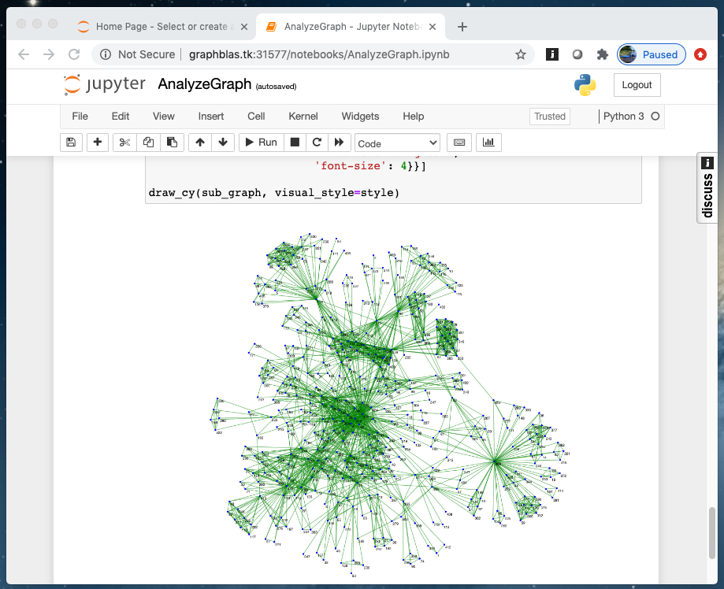
The result (after a few minutes)
Subset of graph of coauthors: vertices are authors, edges connect authors who’ve published HPEC papers together

Slide 27
Outline
Graphs and Linear Algebra
The GraphBLAS API and Adjacency Matrices
GraphBLAS Operations
Pygraphblas and modifying the behavior of operations.
Graph Algorithms expressed with GraphBLAS
Breadth-First Traversal
Connected Components
Triangle Counting
PageRank

Slide 28
The GraphBLAS API: Maps Math Spec onto the C programming language
Opaque object: An object manipulated strictly through the GraphBLAS API whose implementation is not defined by the GraphBLAS specification.
GrB_Matrix | → A 2D sparse array, row indices, column indices and values
GrB_Vector | → A 1D sparse array
Method: Any function that manipulates a GraphBLAS opaque object.
Domain: the set of available values used for the elements of matrices, the elements of vectors, and when defining operators.
Examples are GrB_UINT64, GrB_INT32, GrB_BOOL, GrB_FP32
Operation: a method that corresponds to an operation defined in the GraphBLAS math spec. http://www.mit.edu/~kepner/GraphBLAS/GraphBLAS-Math-release.pdf
GrB_mxv(C, GrB_NULL, GrB_NULL, GrB_LOR_LAND_BOOL, A, B, GrB_NULL);
GrB_mxv(w, GrB_NULL, GrB_NULL, GrB_LOR_LAND_BOOL, A, v, GrB_NULL);
GrB_eWiseAdd(C, GrB_NULL, GrB_NULL, GrB_LOR, A, B, GrB_NULL);

Slide 29
The GraphBLAS API: pygraphblas Maps the C API onto Python
Opaque object: An object manipulated strictly through the GraphBLAS API whose implementation is not defined by the GraphBLAS specification.
Matrix.sparse | → A 2D sparse array, row indices, column indices and values
Vector.sparse | → A 1D sparse array
Method: Any function that manipulates a GraphBLAS opaque object.
Domain: the set of available values used for the elements of matrices, the elements of vectors, and when defining operators.
Examples are UINT64, INT32, BOOL, FP32
Operation: a method that corresponds to an operation defined in the GraphBLAS math spec. http://www.mit.edu/~kepner/GraphBLAS/GraphBLAS-Math-release.pdf
Matrix multiply | C = A @ B | C = A.mxm(B) or A.mxm(B, out=C)
Matrix Vector | w = A @ v | w = A.mxv(v) or A.mxv(v, out=w)
Element-wise add | C = A + B | C = A.eadd(B) or A.eadd(B, out=C)

Slide 30
GraphBLAS Execution modes
A GraphBLAS program defines a DAG of operations.
Objects are defined by the sequence of GraphBLAS method calls, but the value of the object is not assured until a GraphBLAS method queries its state.
This gives an implementation flexibility to optimize the execution (fusing methods, replacing method sequences by more efficient ones, etc.)
GrB_op1(A);
GrB_op2(B);
GrB_op1(A);
GrB_op2(B);
GrB_op3(C,A,B);
GrB_op3(C,A,B);
An execution of a GraphBLAS program defines a context for the library.
The execution runs in one of two modes:
Blocking mode … executes methods in program order with each method completing before the next is called
Non-Blocking mode … methods launched in order. Complete in any order consistent with the DAG. Objects may not exit in fully defined state until queried.
Pygraphblas uses non-blocking mode
Notes:
Tim Davis says: “SuiteSparse:GraphBLAS uses non-blocking for assign and setElement”
Scott may disagree with the terminology.

Slide 31
Creating a matrix
Matrices in real problems are imported into the program from a file or an external application.
We can build a matrix element by element
Import pygraphblas import pygraphblas as grb
Set size of matrix n = 3
Build a square matrix: A = grb.Matrix.sparse(grb.UINT64,n,n)
Set a value in the matrix A[1,2] = 4
Look at the matrix print(A)
Notes:
It took us an hour to reach this point in the tutorial when we taught this content at HPEC’19

Slide 32
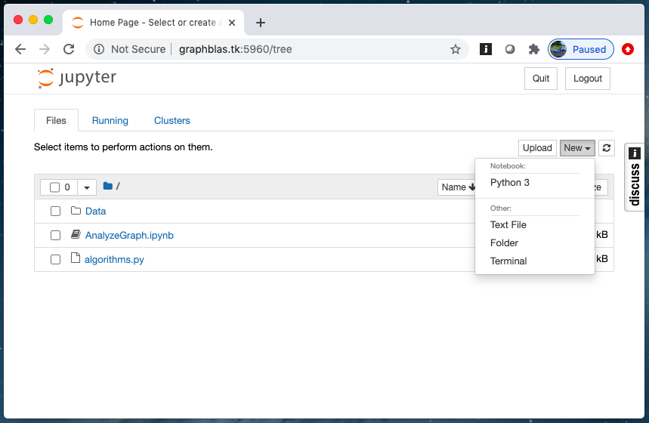
Exercise 2: Your first pygraphblas program
Open a new jupyter notebook with Python 3.
Create a matrix, set a few values, and print the result.
Play around to make sure you are comfortable with the environment
import pygraphblas as grb
A = grb.Matrix.sparse(grb.type, n, n)
A[row,col] = val
some common types are UINT64, BOOL, FP32, INT8, FP64
print(A)
Notes:
It took us an hour to reach this point in the tutorial when we taught this content at HPEC’19

Slide 33
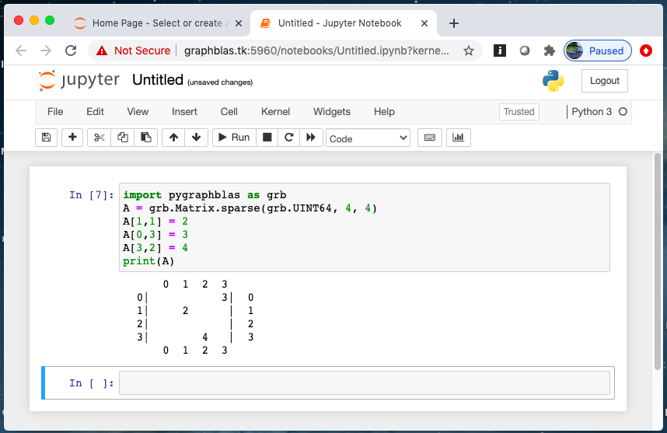
Exercise 2: Your first pygraphblas program
Open a new jupyter notebook with Python 3.
Create a matrix, set a few values, and print the result.
Play around to make sure you are comfortable with the environment
import pygraphblas as grb
A = grb.Matrix.sparse(grb.type, n, n)
A[row,col] = val
some common types are UINT64, BOOL, FP32, INT8, FP64
print(A)
Notes:
It took us an hour to reach this point in the tutorial when we taught this content at HPEC’19

Slide 34
Creating a matrix
Matrices in real problems are imported into the program from a file or an external application.
We can build Matrices from lists:
Import pygraphblas: import pygraphblas as grb
List of row indices: ri = [0, 2, 4, 5]
List of column indices: ci = [1, 3, 5, 5]
List of Values: val = [True]*len(ri)
Build the matrix: A = grb.Matrix.from_lists(ri, ci, val)
Number of columns: NUM_NODES = A.ncol
We can look at a matrix as a matrix (with print) or as a graph:
from pygraphblas.gviz import draw_graph as draw
draw(A)
← A list of True as long as ri
Notes:
It took us an hour to reach this tutorial when we taught this content at HPEC’19

Slide 35
Exercise 3: Adjacency matrix
0
1
Look at the matrix from Exercise 2 as a graph using draw_graph().
Experiment with setting different elements until you are comfortable with the connection between a graph and an adjacency matrix.
Create the adjacency matrix of the “GraphBLAS logo graph” from lists
6
3
4
2
5
Items you will need from the pygraphblas
import pygraphblas as grb
from pygraphblas.gviz import draw_graph as draw
A = grb.Matrix.from_lists(rowList, columnList, valueList)
A = grb.Matrix.sparse(type, n, n)
A[row,col] = val
print(A)
draw(A)
some common types are UINT64, BOOL, FP32, INT8, FP64

Slide 36
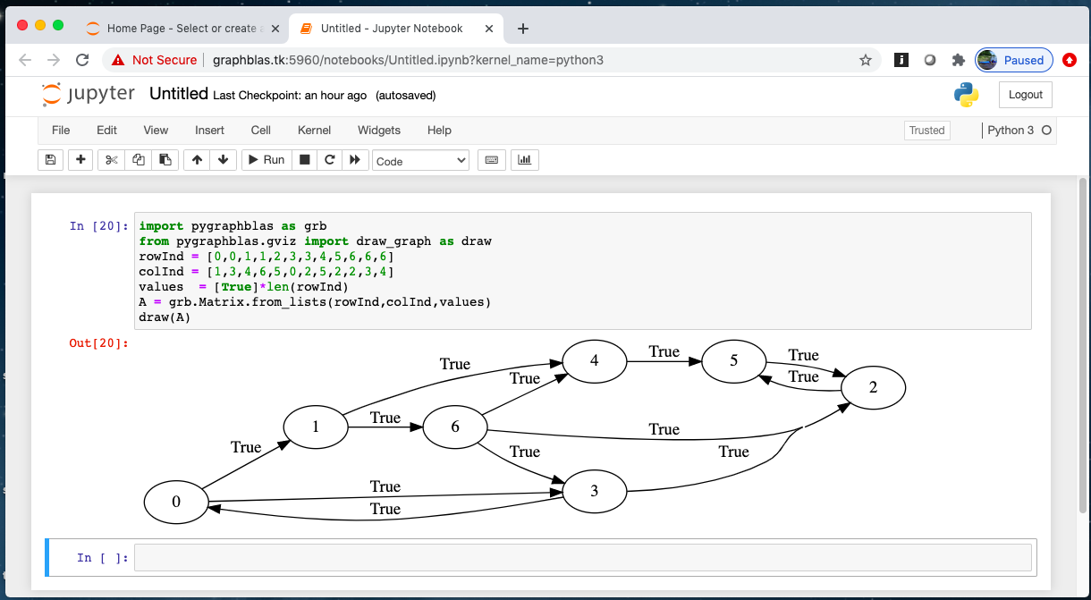
Exercise 3: Adjacency matrix
0
1
6
3
4
2
5

Slide 37
Outline
Graphs and Linear Algebra
The GraphBLAS API and Adjacency Matrices
GraphBLAS Operations
Pygraphblas and modifying the behavior of operations.
Graph Algorithms expressed with GraphBLAS
Breadth-First Traversal
Connected Components
Triangle Counting
PageRank

Slide 38
GraphBLAS vectors and matrices
Let’s review our Matrix and Vector Objects.
They are opaque … the structure is not defined in the spec so implementors have maximum flexibility to optimize their implementation
pygraphblas defines a number of static methods to use when working with matrices and vectors
import pygraphblas as grb
We’ve seen these already
#Create a sparse matrix with Nrows and Ncols
A = grb.Matrix.sparse(type, Nrows, Ncols)
#Create a sparse matrix from index and value lists
A = grb.Matrix.from_lists(rowInd, colInd, valList)
The vector case is analogous to the matrix case
#Create a sparse vector of size N
v = grb.Vector.sparse(type, N)
#Create a sparse vector from index and value lists
v = grb.Vector.from_lists(indList, valList)

Slide 39
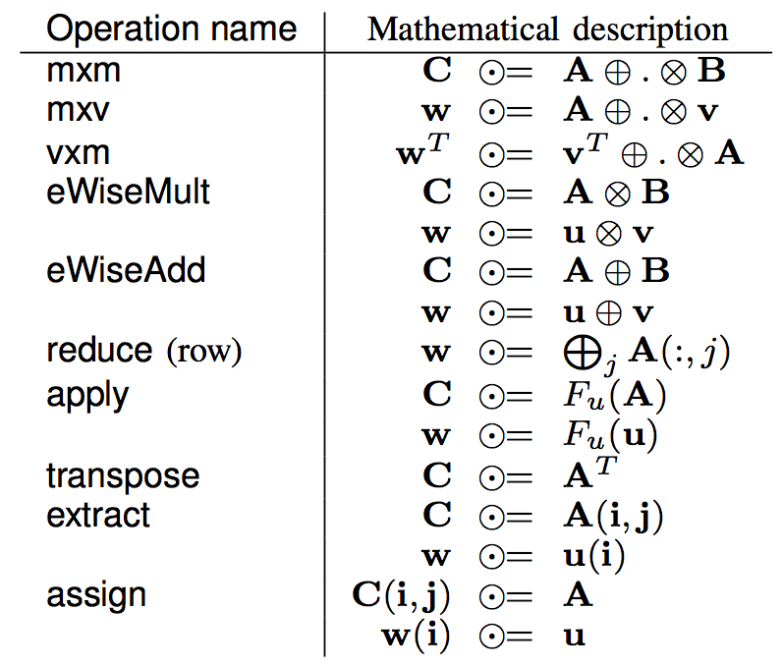
GraphBLAS Operations (from the Math Spec*)
We use ⊙, ⊕, and ⊗ since we can change the operators mapped onto those symbols.
* Mathematical foundations of the GraphBLAS, Kepner et. al. HPEC’2016
Notes:
http://www.mit.edu/~kepner/GraphBLAS/GraphBLAS-Math-release.pdf

Slide 40
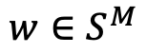
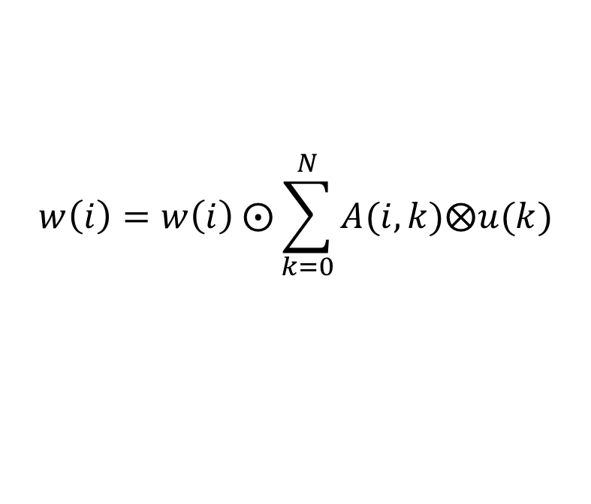

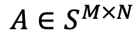
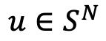
mxv()
$\text{w} ⨀$= A⊕.⊗u
Multiply a matrix times a vector to produce a vector
$$w\left(i\right)=w\left(i\right) ⨀\sum_{k=0}^{N}{A(i,k)⨂u(k)}$$
$$w∈S^{M}$$
$$u∈S^{N}$$
$$A∈S^{M×N}$$
Definitions:
S is the domain of the objects w, u, and A
⊙ is an optional accumulation operator (a binary operator)
⊗ and ⊕ are multiplication and addition (or generalizations thereof)
∑ uses the ⊕ operator

Slide 41
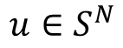
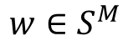
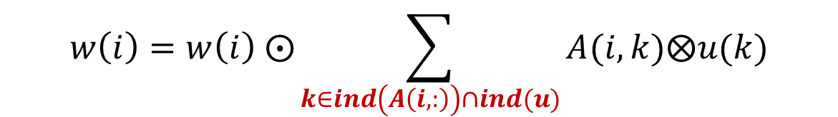
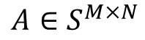
mxv()
$\text{w} ⨀$= A⊕.⊗u
Multiply a matrix times a vector to produce a vector
$$w\left(i\right)=w\left(i\right) ⨀\sum_{k∈ind\left(A\left(i,:\right)\right)∩ind(u)}{A(i,k)⨂u(k)}$$
The summation is over the intersection of the existing elements in the i^{th} row of A with u … which avoids exposing how empty elements (i.e. “zeros”) are represented. This becomes important when we change the semiring between operations
$$w∈S^{M}$$
$$u∈S^{N}$$
$$A∈S^{M×N}$$
Definitions:
S is the domain of the objects w, u, and A
⊙ is an optional accumulation operator (a binary operator)
⊗ and ⊕ are multiplication and addition (or generalizations thereof)
∑ uses the ⊕ operator
ind(u) returns the indices of the stored values of u

Slide 42

Matrix vector multiplication: mxv()
$\text{w} ⨀$= A⊕.⊗u
The operators used are an accumulator (⊙) and the algebraic semiring operators (⊕ and ⊗). We will say a great deal more about semirings later … for now we’ll use the default case for Boolean data, the LOR_LAND semiring (i.e., logical OR for ⊕, Logical AND for ⊗).
import pygraphblas as grb
# A’s type taken from values
A = grb.Matrix.from_lists(rowInd, colInd, values)
N = A.ncols
# Create a vector of length N and type BOOL
u = grb.Vector.sparse(grb.BOOL, N)
u[ind] = True # set the value
w = A.mxv(u)
w = A @ u
A.mxv(u, out=w)
These three compute the same result in w.
The third reuses an existing w.

Slide 43
Exercise 4: Matrix Vector Multiplication
0
1
Use the adjacency matrix from exercise 3 and a vector with a single value to select one of the nodes in the graph.
Find the product mxv, print the result, and interpret its meaning.
You’ll need the following from pygraphblas:
6
4
3
2
5
import pygraphblas as grb
from pygraphblas.gviz import draw_graph as draw
A = grb.Matrix.from_lists(rowList, columnList, values)
u = grb.Vector.sparse(grb.BOOL, N)
w = A.mxv(u)
A.mxv(u, out=w) # reuse a w that already exists
w = A @ u
print(A), print(w)
draw(A)

Slide 44
Solution to exercise 4
1
0
NODES = 7
u = grb.Vector.sparse(grb.BOOL, NODES)
u[2] = True
w = A @ u
print(w)
6
4
3
2
5
w
0|
1|
2|
3| t
4|
5| t
6| t
A
0 1 2 3 4 5 6
0| t t | 0
1| t t| 1
2| t | 2
3| t t | 3
4| t | 4
5| t | 5
6| t t t | 6
0 1 2 3 4 5 6
u
0|
1|
2| t
3|
4|
5|
6|
=
@
Notes:
src/Solutions/matvec.c
Todo: mention 1-hop in the explanation. This helps build to BFS. This is traversing edges backwards!

Slide 45
Solution to exercise 4
0
1
Nodes = 7
u=grb.Vector.sparse(grb.BOOL,Nodes)
u[2] = True
w=A@u
print(w)
6
4
3
2
5
w
0|
1|
2|
3| t
4|
5| t
6| t
A
0 1 2 3 4 5 6
0| t t | 0
1| t t| 1
2| t | 2
3| t t | 3
4| t | 4
5| t | 5
6| t t t | 6
0 1 2 3 4 5 6
u
0|
1|
2| t
3|
4|
5|
6|
=
@
The stored elements of the adjacency matrix, A(i,j) indicate an edge from vertex i to vertex j
So the matrix vector product scans over a row (from) to find when an edge lands at the destination
Notes:
src/Solutions/matvec.c
Todo: mention 1-hop in the explanation. This helps build to BFS. This is traversing edges backwards!

Slide 46
Finding neighbors
A more common operation is to input a vector selecting a source and find all the neighbors one hop away from that vertex.
Using mxv(), how would you do this?

Slide 47
Finding neighbors
A more common operation is to input a vector selecting a source and find all the neighbors one hop away from that vertex.
Using mxv(), how would you do this?
The adjacency matrix elements indicate edges
From a vertex (row index)
To another vertex (columns index)
Then the transpose of the adjacency matrix indicates edges
To a vertex (row index)
From other vertices (column index)
Therefore, we can find the neighbors of a vertex (marked by the non-empty elements of v)
neighbors = A^{T}⊕.⊗v
Two ways using pygraphblas
neighbors = A.T @ v
neighbors = A.mxv(v, desc=grb.descriptor.T0)

Slide 48
Exercise 5: Find one hop neighbors
0
1
This is a really quick exercise.
Go back to your code for exercise 4 and verify that you can use the transpose to find the one hop neighbors of a source vertex.
6
4
3
2
5
import pygraphblas as grb
from pygraphblas.gviz import draw_graph as draw
A = grb.Matrix.from_lists(rowList, columnList, values)
u = grb.Vector.sparse(grb.BOOL, N)
Atrans = A.T
w = A.mxv(u)
A.mxv(u, out=w)
w = A @ u
print(A)
draw(A)

Slide 49
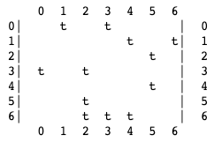
Solution to exercise 5: Find one-hop neighbors
NODES = 7
u = grb.Vector.sparse(grb.BOOL, NODES)
u[6] = True
w = A.T @ u
print(w)
A
w
0|
1|
2| t
3| t
4| t
5|
6|
A^{T}
0 1 2 3 4 5 6
0| t | 0
1| t | 1
2| t t t| 2
3| t t| 3
4| t t| 4
5| t t | 5
6| t | 6
0 1 2 3 4 5 6
u
0|
1|
2|
3|
4|
5|
6| t
=
@
Notes:
src/Solutions/matvec.c
Todo: mention 1-hop in the explanation. This helps build to BFS. This is traversing edges backwards!

Slide 50
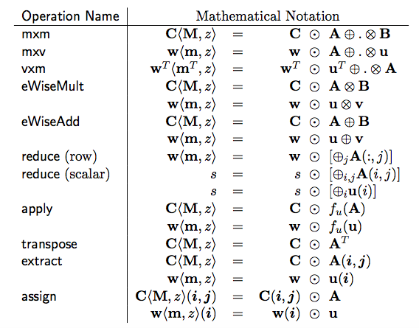
The GraphBLAS Operations
We’ve only covered mxv, so far, but the same conventions are used across all operations, so we’ll have no problem later when we use the others
<M, m>: write masks (Matrix or vector).
<z>: selects “replace or combine” for elements not selected by the mask.

Slide 51
Outline
Graphs and Linear Algebra
The GraphBLAS API and Adjacency Matrices
GraphBLAS Operations
Pygraphblas and modifying the behavior of operations.
Graph Algorithms expressed with GraphBLAS
Breadth-First Traversal
Connected Components
Triangle Counting
PageRank

Slide 52
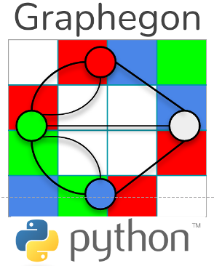
pygraphblas:
A python wrapper around the SuiteSparse GraphBLAS library.
Brought to us by Michel Pelletier and his company Graphegon.
pygraphblas uses CFFI to automate much of the process of generating an interface to SuiteSparse GraphBAS library … thus helping pygraphblas to closely track new releases of SuiteSparse.
Open-Source release … also provided as docker containers:
Minimal: an Ipython interpreter-only
Notebook: Includes a Jupyter notebook server
Documentation for pygraphblas (with lots of examples) can be found here:
https://graphegon.github.io/pygraphblas/pygraphblas/index.html
Notes:
Ipython is an interactive shell for use with python.

Slide 53
pygraphblas: Matrix and Vector part 1
Matrix constructors … commonly used cases:
sparse(typ, nrows=None, ncols=None)
dense(typ, nrows, ncols, fill=None, sparsity=None)
from_lists(I, J, V, nrows=None, ncols=None, typ=None)
dup(A)
random(typ, nrows, ncols, nvals, make_pattern=False, make_symmetric=False, make_skew_symmetric=False, make_hermitian=True, no_diagonal=False, seed=None)
Vector constructors … commonly used cases:
sparse(typ, size=None)
from_lists(I, V, size=None, typ=None)
from_1_to_n(n)
dense(typ, size, fill=None)
dup(v)
Common types (typ) are: BOOL, FP64, FP32, INT64, INT32, INT16, INT8, UINT64, UINT32, UINT16, UINT8
For arguments with default value None, if the argument is not provided, pygraphblas will infer what it needs from the other arguments
import pygraphblas as grb
N = 8
Nval = 16
graph = grb.Matrix.random(grb.INT8,N,N,Nval,make_symmetric=True)
g2 = graph.dup()
vec = grb.Vector.from_1_to_n(N)
res = g2@vec

Slide 54
pygraphblas: Matrices and Vectors part 2
Matrix with Instance attributes and properties … a few of which are:
nrows
ncols
nvals
T ← take the transpose of the matrix
M ← create a bool matrix, true where a defined element exists
get(i,j,default=None)
Vector with Instance attributes and properties … a few of which are:
size
nvals
Indexes
get(i, ,default=None)
import pygraphblas as grb
g2 = grb.Matrix.from_lists([1,1,2],[1,2,0],[4,-5,0])
gm = graph.M
g4 = grb.Matrix.mxm(g2, g2.T, mask=gm)
NUM_NODES = g2.nrows
vec = grb.Vector.from_1_to_n(NUM_NODES)
for i in vec.indexes:
do_something(i)
jj = vec.size/2
print(vec.get(jj,default=10))
Uses a write-mask to select elements of the product to store
Using an iterator over the vector
Extract element jj. If there is no element jj, then return the default value 10 (the default default is None)

Slide 55
Changing the behavior of a GraphBLAS operation
Most GraphBLAS operations take an argument that is an opaque object called a “descriptor”.
The descriptor controls the behavior of the method and how objects are handled inside the method.
The descriptor controls:
Do you transpose input matrices?
T0 ← transpose first argument
T1 ← transpose second argument
Does the computation replace existing values in the output object or combine with them when a mask is used?
Take the structure and/or complement of the mask object (swap empty/false ←→ filled/true values in a sparse object).
They can be combined:
T0T1 ← transpose both args
….To be discussed later
Descriptor example: Hop = A.mxm(B, desc = grb.descriptor.T0)
A pygraphblas descriptor is a distinct module so you must specify it as such when used.
In this example, T0 transposes A. T1 would transpose B

Slide 56
Exercise 6: find one hop neighbors (again)
0
1
This is a really quick exercise.
Go back to your code for exercise 5 and verify that you can specify a descriptor to use the transpose to find the one hop neighbors of a source vertex.
6
4
3
2
5
import pygraphblas as grb
from pygraphblas.gviz import draw_graph as draw
A = grb.Matrix.from_lists(rowList, columnList, values)
u = grb.Vector.sparse(grb.BOOL, N)
Atrans = A.T
w = A.mxv(u, desc = ??)
A.mxv(u, out=w, desc = ??)
print(A)
draw(A)

Slide 57
Solution to exercise 6: Find one-hop neighbors
NODES = 7
u = grb.Vector.sparse(grb.BOOL, NODES)
u[6] = True
w = A.mxv(u, desc = grb.descriptor.T0)
print(w)
A
w
0|
1|
2| t
3| t
4| t
5|
6|
A^{T}
0 1 2 3 4 5 6
0| t | 0
1| t | 1
2| t t t| 2
3| t t| 3
4| t t| 4
5| t t | 5
6| t | 6
0 1 2 3 4 5 6
u
0|
1|
2|
3|
4|
5|
6| t
=
@
Notes:
src/Solutions/matvec.c
Todo: mention 1-hop in the explanation. This helps build to BFS. This is traversing edges backwards!

Slide 58
Matrix vector multiplication: mxv()
$\text{w} ⨀$= A⊕.⊗u
It’s time to say more about these operators
The operators in GraphBLAS operations are:
Accumulator ⊙
Addition ⊕
Multiplication ⊗
The operators are implied by type.
Pygraphblas type | ⊙ | ⊕ | ⊗
types.BOOL | LOR | LOR | LAND
types.INT32 | 32 bit int add | 32 bit int add | 32 bit int multiply
types.FP32 | 32 bit float add | 32 bit float add | 32 bit float multiply
import pygraphblas as grb
# Matrix A and vectors w and u defined elsewhere.
# Assume they are of type INT32
A.mxv(u,accum=grb.INT32.PLUS,out=w)
Implicit ⊕ and ⊗ based on type of A, u, and/or w. ⊙ defined explicitly
⊕.⊗ are considered together as part of an algebraic semiring (our next topic)

Slide 59
Algebraic Semirings
Semiring: An Algebraic structure that generalizes real arithmetic by replacing (⊕,⊗) with binary operations (Op1, Op2)
Op1 and Op2 have identity elements sometimes called 0 and 1
Op1 and Op2 are associative.
Op1 is commutative, Op2 distributes over Op1 from both left and right
The Op1 identity is an Op2 annihilator.

Slide 60
Algebraic Semirings
Semiring: An Algebraic structure that generalizes real arithmetic by replacing (⊕,⊗) with binary operations (Op1, Op2)
Op1 and Op2 have identity elements sometimes called 0 and 1
Op1 and Op2 are associative.
Op1 is commutative, Op2 distributes over Op1 from both left and right
The Op1 identify is an Op2 annihilator.
(R, +, *, 0, 1) Real Field | Standard operations in linear algebra
({0,1}, |, &, 0, 1) Boolean Semiring | Graph traversal algorithms
(R U {∞},min, +, ∞, 0) Tropical semiring | Shortest path algorithms
(R U {∞}, min, x, ∞, 1) | Selecting a subgraph or contracting nodes to form a quotient graph.
Notation: (R, +, *, 0, 1)
Scalar type
Op1
Op2
Identity Op1
Identity Op2

Slide 61
Algebraic Semirings
Semiring: An Algebraic structure that generalizes real arithmetic by replacing (⊕,⊗) with binary operations (Op1, Op2)
Op1 and Op2 have identity elements sometimes called 0 and 1
Op1 and Op2 are associative.
Op1 is commutative, Op2 distributes over Op1 from both left and right
The Op1 identify is an Op2 annihilator.
(R, +, *, 0, 1) Real Field | Standard operations in linear algebra
(R U {∞},min, +, ∞, 0) Tropical semiring | Shortest path algorithms
({0,1}, |, &, 0, 1) Boolean Semiring | Graph traversal algorithms
(R U {∞}, min, *, ∞, 1) | Selecting a subgraph or contracting nodes to form a quotient graph.
Notes:
False and true for boolean semiring???

Slide 62
Working with semirings
In Graph Algorithms, changing semirings multiple times inside a single algorithm is quite common. Hence, the semiring (and implied accumulator ⊕ by default) can be directly manipulated.
We can do this using python’s with statement
with grb.BOOL.LOR_LAND:
w += A@v
with grb.BOOL.LOR_LAND:
w = A.mxv(u,accum=grb.BOOL.LOR)
Matrix vector product of A and v accumulating the result with the existing elements of w using:
⊕ = ⊙ = Logical OR
⊗ = Logical AND
Common semirings include (though pygraphblas has MANY more)
(R, +, *, 0, 1) Real Field | Standard operations in linear algebra | FP64.PLUS_TIMES
(R U {∞},min, +, ∞, 0) Tropical semiring | Shortest path algorithms | FP64.MIN_PLUS
({0,1}, |, &, 0, 1) Boolean Semiring | Graph traversal algorithms | BOOL.LOR_LAND
(R U {∞}, min, *, ∞, 1) | Selecting a subgraph or contracting nodes to form a quotient graph. | FP64.MIN_TIMES

Slide 63
Exercise 7: find one hop neighbors (again)
0
1
This is a really quick exercise.
Go back to your code for exercise 6 and verify that you can specify the semiring to find the one hop neighbors of a source vertex.
6
4
3
2
5
import pygraphblas as grb
from pygraphblas.gviz import draw_graph as draw
A = grb.Matrix.from_lists(rowList, columnList, values)
u = grb.Vector.sparse(grb.BOOL, N)
Atrans = A.T
with grb.<type>.<semiring>:
w = A.mxv(u, desc = ??)
A.mxv(u, out=w, desc = ??)
print(A)
draw(A)

Slide 64
Solution to exercise 7: Find one-hop neighbors
NODES = 7
u = grb.Vector.sparse(grb.BOOL, NODES)
u[6] = True
with grb.BOOL.LOR_LAND:
w = A.mxv(u, desc = grb.descriptor.T0)
print(w)
A
w
0|
1|
2| t
3| t
4| t
5|
6|
A^{T}
0 1 2 3 4 5 6
0| t | 0
1| t | 1
2| t t t| 2
3| t t| 3
4| t t| 4
5| t t | 5
6| t | 6
0 1 2 3 4 5 6
u
0|
1|
2|
3|
4|
5|
6| t
=
@
Notes:
src/Solutions/matvec.c
Todo: mention 1-hop in the explanation. This helps build to BFS. This is traversing edges backwards!

Slide 65
Pygraphblas Documentation
We have only covered a small portion of the GraphBLAS.
Pygraphblas has much more to offer.
Documentation is available at:
https://graphegon.github.io/pygraphblas/pygraphblas/index.html
The pygraphblas documentation describes:
Numerous additional semirings organized by type.
Numerous binary and unary functions so you can choose your own accumulators or build custom semirings.
The ability to create custom binary and unary operators using a JIT decorator.
Options to control multithreading and other internal features of the SuiteSparse GraphBLAS library
The pygraphblas.gviz sub-module which includes methods for looking at small graphs but also a binding to the Cytoscape module for working with large complex graphs

Slide 66
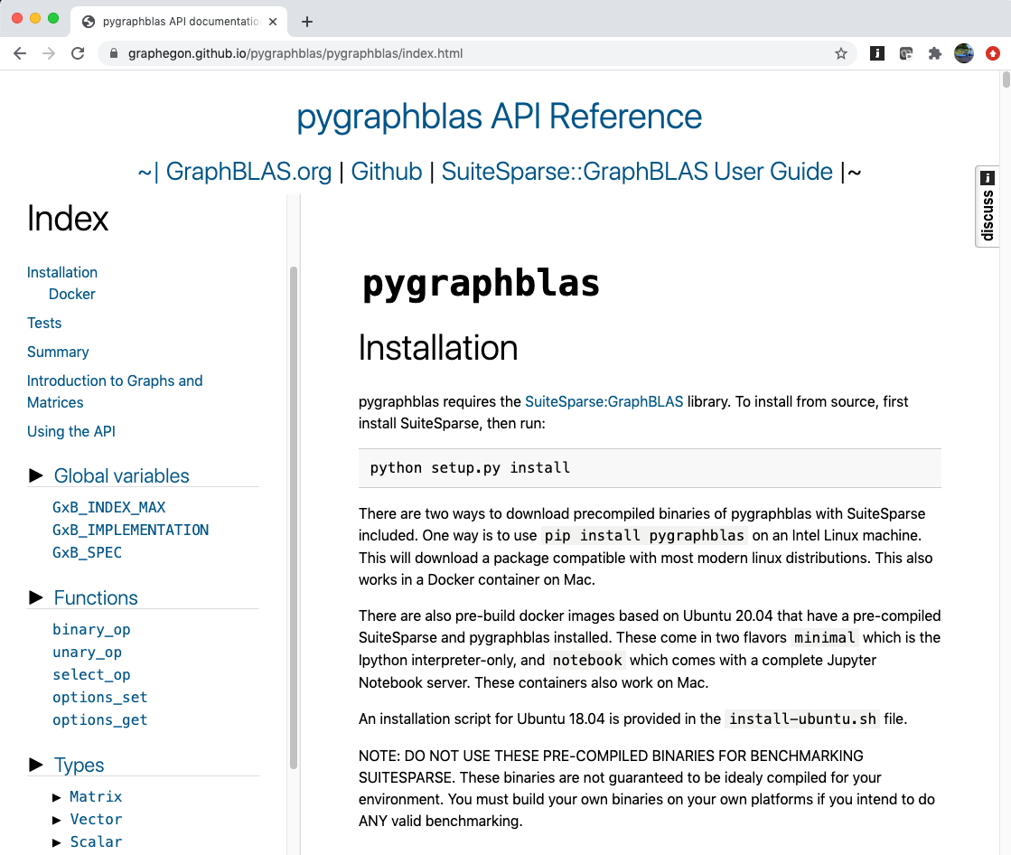

Slide 67
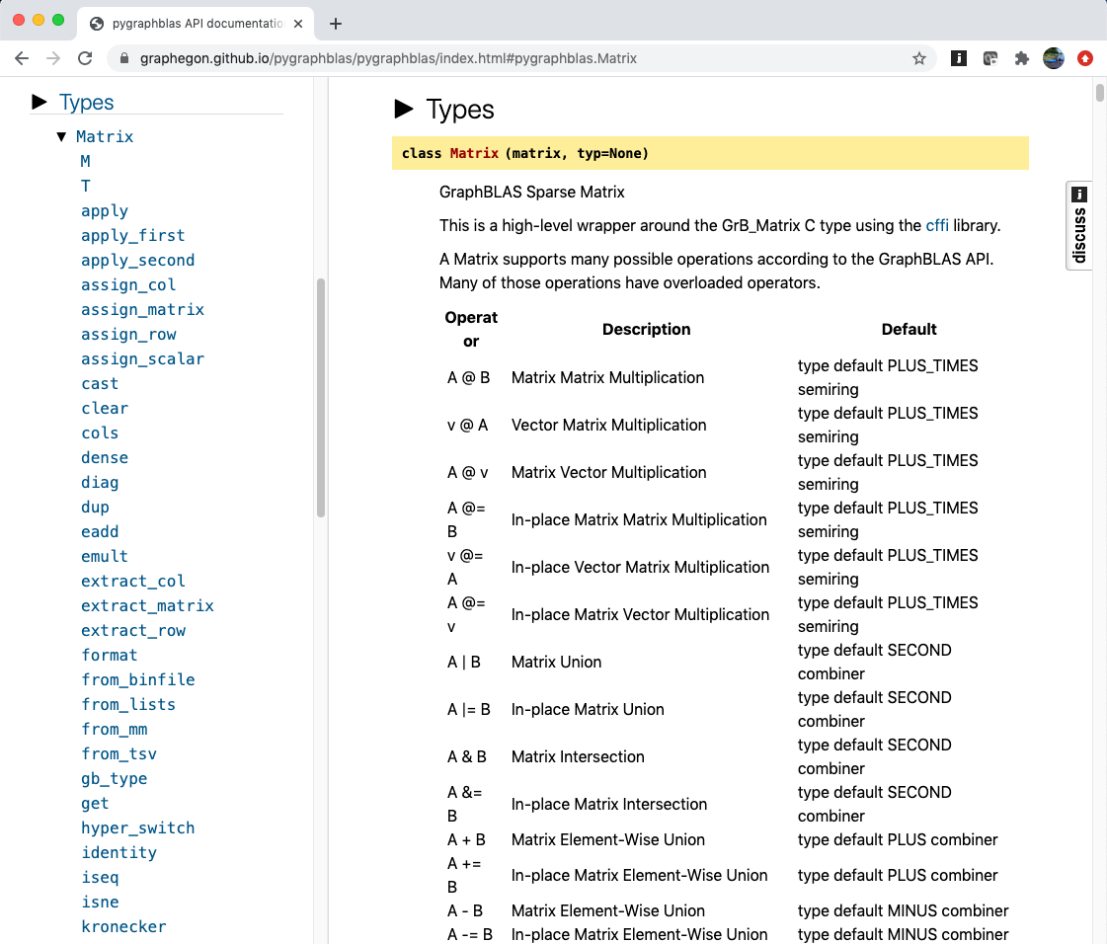

Slide 68
Outline
Graphs and Linear Algebra
The GraphBLAS API and Adjacency Matrices
GraphBLAS Operations
Pygraphblas and modifying the behavior of operations.
Graph Algorithms expressed with GraphBLAS
Breadth-First Traversal
Connected Components
Triangle Counting
PageRank

Slide 69
Breadth First Traversal (aka BFS)
The Breadth First Traversal:
Start from one or more initial vertices
Visit all accessible one hop neighbors
Visit all accessible unique two hop neighbors
Continue until there are no more unique vertices to visit
Note: Need to keep track of vertices visited so you don’t visit the same vertex more than once
Breadth first traversal is a common pattern used in a variety of graph algorithms
Build a spanning tree that contains all vertices and minimal number of edges
Search for accessible vertices with certain properties.
Find shortest paths between vertices.
Other more advanced algorithms such as maxflow and betweenness centrality

Slide 70
Our Breadth First Traversal plan
We will build up this algorithm using the GraphBLAS through a series of exercises:
Wavefronts and how to move from one wavefront to the next.
Iteration across wavefronts
Track which vertices have been visited
Avoid revisiting vertices
*** At this point you have a basic BFS algorithm. ***
Use this to construct a Connected Components algorithm
Notes:
Introduce the concept of a wavefront (which is the result of the first mxv that is fed in as input to the second (the initial source vertex vector is also a wavefront).
So you have to add a loop, the exit condition for the loop is an empty vector so using call to Vector_nvals
But without doing anything this will traverse back to previously visited vectors (infinite loop).
Need to create a visited vector which is boolean and ANDs with the results of each mxv (introduces eWiseMult)
GrB_eWiseAdd(visited, NULL, NULL, LAND, wavefront, visited, NULL);
(LEAP) you can use complement of the visited vector as a mask to the wavefront (in self-assignment
Need to introduce mask, SCMP descriptor, and apply:
wavefront = apply(IDENTITY) of wavefront masked by complement of visited (AND you need to use replace)
(Alternative) UGH
It is too hard to introduce a new binary op in order to avoid the use of mask
After step 4 it is easy to roll the SCMP mask into the mxv itself and avoid the assign.
Turning this into a level BFS means that the visited vector uses integer domain
Introduce a depth/level variable and use assign constant variant (before the mxv) to assign elements of visited with the depth variable: GrB_assign(levels, wavefront, NULL, depth, GrB_ALL, NUM_NODES, NULL)

Slide 71
Wavefronts
A subset of vertices accessed at one stage in a breadth first search pattern … for example ….
“You tell two friends, and they tell two friends…”
0
1
0
1
6
6
3
4
3
4
2
5
2
5
A^{T} w = w’
A^{T} w’ = w’’
w = {0}
w’ = {1, 3}
w’’ = {0, 2, 4, 6}
Red=current wavefront and visited, Blue=next wavefront, Black=unvisited
A = Adjacency Matrix w = wavefront vectors

Slide 72
Exercise 8: Traverse the graph
Modify your code from Exercises 5/6/7 to iterate from one wavefront to the next.
Output each wavefront
How long before you get a repeating pattern?
You may need the following statements, objects and methods from pygraphblas:
import pygraphblas as grb
from pygraphblas.gviz import draw_graph as draw
A = grb.Matrix.from_lists(rowList, columnList, values)
u = grb.Vector.sparse(grb.<type>, N)
Atrans = A.T
with grb.<type>.<semiring>:
w = A.mxv(u, desc = ??)
A.mxv(u, out=w, desc = ??)
print(A)
draw(A)
Notes:
GrB_Vector result, vec;
GrB_Index NODE;
GrB_Vector_new(&vec, GrB_BOOL, NUM_NODES);
GrB_Vector_setElement(vec, true, NODE);
pretty_print_vector_UINT64(vec, "Input node");
GrB_Descriptor desc;
GrB_Descriptor_new(&desc);
GrB_Descriptor_set(desc, FIELD, VALUE)
GrB_mxv(result, GrB_NULL, GrB_NULL,
GxB_LOR_LAND_BOOL, graph, vec, desc);

Slide 73
Solution to exercise 8
0
1
6
4
NUM_NODES = 7;
w = grb.Vector.sparse(grb.BOOL, NUM_NODES);
w[0] = True # 1st wavefront has one node set.
print(w)
with grb.BOOL.LOR_LAND:
for i in range(NUM_NODES):
graph.mxv(w, out=w, desc=grb.descriptor.T0)
print(w)
3
2
5
Init.
0| t
1|
2|
3|
4|
5|
6|
i=0
0|
1| t
2|
3| t
4|
5|
6|
i=1
0| t
1|
2| t
3|
4| t
5|
6| t
i=2
0|
1| t
2| t
3| t
4| t
5| t
6|
i=3
0| t
1|
2| t
3|
4| t
5| t
6| t
i=4
0|
1| t
2| t
3| t
4| t
5| t
6|
i=5
0| t
1|
2| t
3|
4| t
5| t
6| t
i=6
0|
1| t
2| t
3| t
4| t
5| t
6|
The same vector can be used for both input and output.
Starts repeating after only a few iterations. Why?
Notes:
src/Solutions/matvecTransIter (v2)
It should start repeating at about the diameter of the graph

Slide 74
Solution to exercise 8: wavefronts
“We tell a bunch, and they tell bunch…(rinse and repeat)”
0
1
0
1
6
6
3
4
3
4
2
5
2
5
A^{T} w = w’
A^{T} w’ = w
w = {0, 2, 4, 5, 6}
w’ = {1, 2, 3, 4, 5}
w = {0, 2, 4, 5, 6}
Red=current wavefront and visited, Blue=next wavefront, Black=unvisited

Slide 75
Visited lists
Breadth-first traversal requires that we only need to visit each node once.
Next step is to keep track of visited nodes.
You can do this by accumulating the wavefronts.
Use element-wise “addition” with logical-OR.

Slide 76

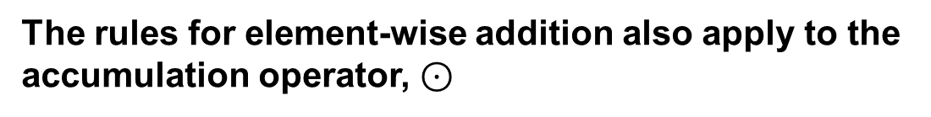
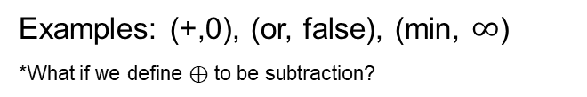
Element-wise Operations: Mult and Add
⊗ assumes unstored values (-) are the binary operator’s annihilator:
⊕ assumes unstored values (-) are the binary operator’s identity:
u ⊗ v
u ⊕ v
⊗
⊕
-
-
-
-
=
=
⊗
⊕
-
-
-
-
-
-
-
-
-
-
Examples: (x,0), (and, false), (+, $∞$)
Examples: (+,0), (or, false), (min, $∞$)
*What if we define ⊕ to be subtraction?
The rules for element-wise addition also apply to the accumulation operator, $⊙$
Notes:
When performing \circleplus and \circletimes on the same containers the unstored element should be interpreted as the same.

Slide 77
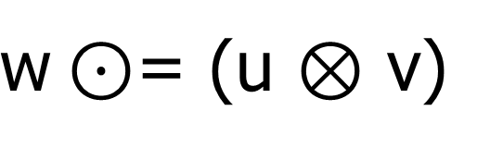
Element-wise Multiplication
$\text{w}⊙$= (u ⊗ v)
Compute the element-wise “multiplication” of two GraphBLAS vectors.
Performs the implicit or explicit “multiply” operator (mult_op) on the intersection of the sparse entries in each input vector, u and v.
emult defined as a member function of Vector class (also Matrix class)
import pygraphblas as grb
u = grb.Vector.sparse(grb.BOOL, NODES);
v = grb.Vector.sparse(grb.BOOL, NODES);
# using an implicit operator (LAND)
v *= u
w = u * v
w = u.emult(v)
u.emult(v, out=w)
# using an explicit operator (LAND)
w = u.emult(v, mult_op=grb.BOOL.LAND)
# using a context manager
with grb.BOOL.LAND:
w = u.emult(v)
u.emult(v, out=w)
In-place element-wise multiplication.
These three compute the same result in w.
The third reuses an existing w.
These three compute the same result in w, too.

Slide 78
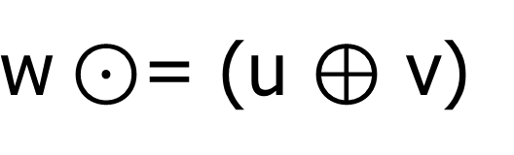
Element-wise Addition
$\text{w}⊙$= (u ⊕ v)
Compute the element-wise “addition” of two GraphBLAS vectors.
Performs the implied or explicit “addition” operator (add_op) on the union of the sparse entries in each input vector, u and v.
eadd defined as a member function of Vector class (also Matrix class)
import pygraphblas as grb
u = grb.Vector.sparse(grb.BOOL, NODES);
v = grb.Vector.sparse(grb.BOOL, NODES);
# using an implicit operator (LOR)
v += u
w = u + v
w = u.eadd(v)
u.eadd(v, out=w)
# using an explicit operator (LOR)
w = u.eadd(v, add_op=grb.BOOL.LOR)
# using a context manager
with grb.BOOL.LOR:
w = u.eadd(v)
u.eadd(v, out=w)
In-place element-wise addition.
These three compute the same result in w.
The third reuses an existing w.
These three compute the same result in w, too.

Slide 79
Exercise 9: Keep track of ‘visited’ nodes
Modify code from Exercise 8 to compute the visited set as you iterate.
You may need the following statements, objects and methods from pygraphblas:
import pygraphblas as grb
from pygraphblas.gviz import draw_graph as draw
A = grb.Matrix.from_lists(rowList, columnList, values)
u = grb.Vector.sparse(grb.BOOL, N)
Atrans = A.T
with grb.<type>.<semiring>:
w = A.mxv(u, desc = ??)
v = w.eadd(v)
v += w
A.mxv(u, out=w, desc = ??)
print(A)
draw(A)

Slide 80
Solution to exercise 9
0
1
NODES = 7;
v = grb.Vector.sparse(grb.BOOL, NODES);
w = grb.Vector.sparse(grb.BOOL, NODES);
w[0] = True # 1st wavefront has one node set.
with grb.BOOL.LOR_LAND:
for i in range(NUM_NODES):
v.eadd(w, out=v, add_op=grb.BOOL.LOR) # v += w
print(v)
graph.mxv(w, out=w, desc=grb.descriptor.T0) # w = graph.T @ w
print(w)
6
4
3
2
5
i=0
0| t
1|
2|
3|
4|
5|
6|
i=1
0| t
1| t
2|
3| t
4|
5|
6|
i=2
0| t
1| t
2| t
3| t
4| t
5|
6| t
i=3
0| t
1| t
2| t
3| t
4| t
5| t
6| t
i=4
0| t
1| t
2| t
3| t
4| t
5| t
6| t
i=5
0| t
1| t
2| t
3| t
4| t
5| t
6| t
i=6
0| t
1| t
2| t
3| t
4| t
5| t
6| t
v
0|
1| t
2|
3| t
4|
5|
6|
0| t
1|
2| t
3|
4| t
5|
6| t
0|
1| t
2| t
3| t
4| t
5| t
6|
0| t
1|
2| t
3|
4| t
5| t
6| t
0|
1| t
2| t
3| t
4| t
5| t
6|
0| t
1|
2| t
3|
4| t
5| t
6| t
0|
1| t
2| t
3| t
4| t
5| t
6|
w
Notes:
src/Solutions/matvecTransIter (v2)
It should start repeating at about the diameter of the graph

Slide 81
Solution to exercise 9
0
1
NODES = 7;
v = grb.Vector.sparse(grb.BOOL, NODES);
w = grb.Vector.sparse(grb.BOOL, NODES);
w[0] = True # 1st wavefront has one node set.
with grb.BOOL.LOR_LAND:
for i in range(NUM_NODES):
v.eadd(w, out=v, add_op=grb.BOOL.LOR) # v += w
print(v)
graph.mxv(w, out=w, desc=grb.descriptor.T0) # w = graph.T @ w
print(w)
6
4
3
2
5
i=0
0| t
1|
2|
3|
4|
5|
6|
i=1
0| t
1| t
2|
3| t
4|
5|
6|
What should the exit condition be?
i=2
0| t
1| t
2| t
3| t
4| t
5|
6| t
i=3
0| t
1| t
2| t
3| t
4| t
5| t
6| t
i=4
0| t
1| t
2| t
3| t
4| t
5| t
6| t
i=5
0| t
1| t
2| t
3| t
4| t
5| t
6| t
i=6
0| t
1| t
2| t
3| t
4| t
5| t
6| t
v
0|
1| t
2|
3| t
4|
5|
6|
0| t
1|
2| t
3|
4| t
5|
6| t
0|
1| t
2| t
3| t
4| t
5| t
6|
0| t
1|
2| t
3|
4| t
5| t
6| t
0|
1| t
2| t
3| t
4| t
5| t
6|
0| t
1|
2| t
3|
4| t
5| t
6| t
0|
1| t
2| t
3| t
4| t
5| t
6|
w
Notes:
src/Solutions/matvecTransIter (v2)
It should start repeating at about the diameter of the graph

Slide 82

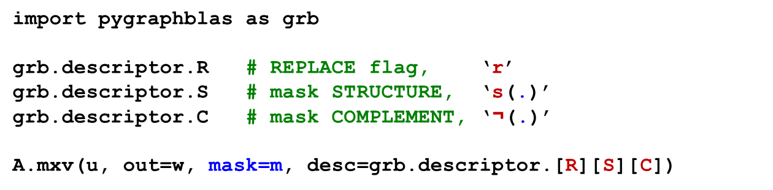
mxv() revisited
$\text{w}\text{⟨}\text{¬}\text{s}\text{(}\text{m}\text{)}\text{, }\text{r}\text{⟩} ⨀$= A ⊕.⊗ u
We now need to go back and introduce more notation that will support more efficient graph operations.
Every GraphBLAS operation that produces a Vector or Matrix result supports an optional write mask.
Three new descriptor flags can be used to affect mask behavior.
import pygraphblas as grb
grb.descriptor.R # REPLACE flag, ‘r’
grb.descriptor.S # mask STRUCTURE, ‘s(.)’
grb.descriptor.C # mask COMPLEMENT, ‘$\text{¬}$(.)’
A.mxv(u, out=w, mask=m, desc=grb.descriptor.[R][S][C])
It’s time to explain masking and REPLACE in GraphBLAS operations.

Slide 83
Masking
A mask, m, is interpreted as a logical ‘stencil’ that controls which elements of the result can be written to the output
Any location in the mask that evaluates to ‘true’ can be written
Same size as output object (mask Vectors or mask Matrices)
Any location in the mask that evaluates to ‘true’ can be written in the output object
w⟨m⟩ = A ⊕.⊗ u
w_{in}
A@u
m
w_{out}
-
T
-
-
T
→
-
→
-
-
-
-
-
-
-
A.mxv(u, out=w, mask=m)

Slide 84
REPLACE vs. “MERGE”
When a mask is used and the output container is not empty when the operation is called…what do you do to the “masked out” elements?
REPLACE (r): all unwritten locations are cleared (zeroed out).
MERGE: all unwritten locations are left unchanged.
Behavior defaults to MERGE; otherwise, use a descriptor.R:
w⟨m, r⟩ = A ⊕.⊗ u
w_{in}
A@u
m
w_{out}
w_{out}
T
REPLACE (r)
MERGE
-
-
T
-
-
→
→
-
-
-
-
-
-
-
-
-
A.mxv(u, out=w, mask=m, [desc=grb.descriptor.R])

Slide 85
Complement (mask)
Specified with a descriptor: grb.descriptor.C
Inverts the logic of mask (write enabled on false)
w⟨¬m, r⟩ = A ⊕.⊗ u
w_{in}
A@u
m
w_{out}
w_{out}
T
-
-
REPLACE, r
MERGE
-
T
→
-
→
-
¬
-
-
-
-
-
-
-
A.mxv(u, out=w, mask=m, desc=grb.descriptor.RC) # REPLACE
A.mxv(u, out=w, mask=m, desc=grb.descriptor.C) # MERGE

Slide 86
Structure only (mask)
Specified with a descriptor: grb.descriptor.S
Writes are enabled by the pattern of stored values (not the values themselves)
w⟨s(m), r⟩ = A ⊕.⊗ u
w_{in}
A@u
m
w_{out}
w_{out}
F
-
REPLACE, r
MERGE
-
T
→
-
→
-
¬
-
-
-
-
-
-
-
-
-
A.mxv(u, out=w, mask=m, desc=grb.descriptor.RS) # REPLACE
A.mxv(u, out=w, mask=m, desc=grb.descriptor.S) # MERGE

Slide 87
Complement the Structure of a mask
Specified with a descriptor: grb.descriptor.SC
Writes are enabled by the pattern of stored values (not the values themselves)…where values are NOT stored
w⟨¬s(m), r⟩ = A ⊕.⊗ u
w_{in}
A@u
m
w_{out}
w_{out}
F
-
-
REPLACE, r
MERGE
-
T
→
-
→
-
¬
-
-
-
-
-
-
-
A.mxv(u, out=w, mask=m, desc=grb.descriptor.RSC) # REPLACE
A.mxv(u, out=w, mask=m, desc=grb.descriptor.SC) # MERGE

Slide 88
Using Descriptors (summary)
All of the possible flags for grb.descriptor:
R: Replace flag (only used when masks are present)
S: Structure of a mask
C: Complement the mask (structure or otherwise)
T0: Transpose the first operand (only when it is a Matrix)
T1: Transpose the second operand (only when it is a Matrix)
All 31 combinations of flags are predefined in a set order:
grb.descriptor.[R][S][C][T0][T1]

Slide 89
Exercise 10: Avoid revisiting
Use the visited list as a mask prevent revisiting previous nodes
Exit the loop when there is no more ‘work’ to be done
You will need the following statements, objects and methods from pygraphblas:
import pygraphblas as grb
from pygraphblas.gviz import draw_graph as draw
A = grb.Matrix.from_lists(rowList, columnList, values)
v = grb.Vector.sparse(grb.BOOL, N)
Atrans = A.T
with grb.<type>.<semiring>:
w = A.mxv(u, desc=??)
v = w.eadd(v)
v += w
v.nvals
v.size
A.mxv(u, out=w, desc = ??)
grb.descriptor.[R][S][C][T0][T1]
print(A)
draw(A)

Slide 90
Solution to exercise 10
0
1
NODES = 7;
v = grb.Vector.sparse(grb.BOOL, NODES);
w = grb.Vector.sparse(grb.BOOL, NODES);
w[0] = True # 1st wavefront has one node set.
with grb.BOOL.LOR_LAND:
while w.nvals > 0:
v.eadd(w, out=v, add_op=grb.BOOL.LOR) # v += w
print(v)
# w<!v, r> = graph.T @ w
graph.mxv(w, mask=v, out=w, desc=grb.descriptor.RCT0)
print(w)
6
4
3
2
5
0|
1|
2|
3|
4|
5|
6|
i=0
0| t
1|
2|
3|
4|
5|
6|
i=1
0| t
1| t
2|
3| t
4|
5|
6|
i=2
0| t
1| t
2| t
3| t
4| t
5|
6| t
i=3
0| t
1| t
2| t
3| t
4| t
5| t
6| t
v
0| t
1|
2|
3|
4|
5|
6|
0|
1| t
2|
3| t
4|
5|
6|
0|
1|
2| t
3|
4| t
5|
6| t
0|
1|
2|
3|
4|
5| t
6|
0|
1|
2|
3|
4|
5|
6|
w
Notes:
src/Solutions/matvecTransIterVisitedExitFlag.c

Slide 91
Breadth-First Traversal
0
1
0
1
6
6
3
4
3
4
2
5
2
5
0
1
0
1
6
6
3
4
3
4
2
5
2
5
Red=current wavefront and visited, Blue=next wavefront, Gray=visited, Black=unvisited

Slide 92
Outline
Graphs and Linear Algebra
The GraphBLAS API and Adjacency Matrices
GraphBLAS Operations
Pygraphblas and modifying the behavior of operations.
Graph Algorithms expressed with GraphBLAS
Breadth-First Traversal
Connected Components
Triangle Counting
PageRank

Slide 93
Connected Components
Connected Components
Identify groups of vertices with paths to one another.
Identify how many of these groups (components) exist in the data.
Goal: assign all vertices within a component with the same unique ID.
For this exercise, the graph will consist of undirected edges
Note: applying this to directed graphs by converting to undirected is called “weakly connected components.”
Nancy
Aydin
1
11
Saday
Jose
3
5
Scott
3
3
1
Ben
2
Tim
7
Margaret

Slide 94
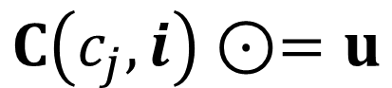
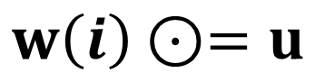
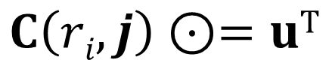
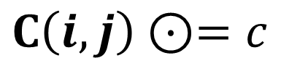
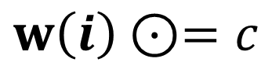
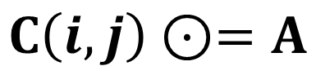
assign(), et al.
There are several variants of assign
Standard vector assignment: w.assign(u, index=I)
Standard matrix assignment: C.assign_matrix(A, rindex=I, cindex=J)
Assign a vector to the elements of column c_{j} of a matrix: C.assign_col(..)
Assign a vector to the elements of row r_{i} of a matrix: C.assign_row(..)
Assign a constant to a subset of a vector: w.assign_scalar(..)
Assign a constant to a subset of a matrix: C.assign_scalar(..)
$$w\left(i\right)⊙=u$$
$$C\left(i,j\right)⊙=A$$
$$C\left(c_{j},i\right)⊙=u$$
$$C\left(ri,j\right)⊙=uT$$
$$w\left(i\right)⊙=c$$
$$C\left(i,j\right)⊙=c$$
A and C are GraphBLAS matrices. u and w are GraphBLAS vectors i and j are index arrays

Slide 95
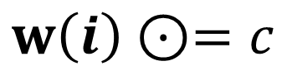
Vector.assign_scalar()
$$w\left(i\right)⊙=c$$
def assign_scalar(self, value, index = None, mask = None, ...)
w = grb.Vector.sparse(grb.INT32, 5)
Assign a constant to a list of indices:
w.assign_scalar(2, [0,3,4])
Assign a constant to a subset of the output with a mask:
m = grb.Vector.from_lists([0,3,4],[True]*3,size=5)
w.assign_scalar(2, mask=m)
Alternative form using the masking:
w[m] = 2
0| 2
1|
2|
3| 2
4| 2
w =

Slide 96
Vector.assign_scalar()
$$w\left(i\right)⊙=c$$
def assign_scalar(self, value, index = None, mask = None, ...)
w = grb.Vector.sparse(grb.INT32, 5)
Assign a constant to a list of indices:
w.assign_scalar(2, [0,3,4])
Assign a constant to a subset of the output with a mask:
m = grb.Vector.from_lists([0,3,4],[True]*3,size=5)
w.assign_scalar(2, mask=m)
Alternative form using the masking:
w[m] = 2
Colon notation is also supported: w[begin:end]:
w[1:4] = 2
Equivalent ways to fill a Vector (index=None):
w[:] = 2
w.assign_scalar(2)
0| 2
1|
2|
3| 2
4| 2
w =
0|
1| 2
2| 2
3| 2
4|
w =
0| 2
1| 2
2| 2
3| 2
4| 2
w =

Slide 97
Our Connected Components plan
Strategy:
Create a new vector and Initialize all vertex IDs to “unassigned”
While there are unassigned vertices:
Pick an unassigned vertex
Perform BFS marking all reachable vertices
Assign all reachable vertices with a unique 'component number’.
Component '1'
Component '42'
Nancy
Aydin
1
11
Saday
Jose
3
5
Scott
3
3
1
Ben
2
Tim
7
Margaret

Slide 98
Our Connected Components plan
We need an undirected graph with disconnected components to play with:
row_ind = [0, 0, 0, 1, 1, 2, 3, 3, 4, 4, 5, 5, 6, 7, 7, 8, 8, 8]
col_ind = [1, 4, 8, 0, 8, 6, 5, 7, 0, 8, 3, 7, 2, 3, 5, 0, 1, 4]
values = [1, 2, 1, 1, 3, 4, 1, 2, 2, 5, 1, 2, 4, 2, 2, 1, 3, 5]
Matrix: GRAPH =
0 1 2 3 4 5 6 7 8
0| 1 2 1| 0
1| 1 3| 1
2| 4 | 2
3| 1 2 | 3
4| 2 5| 4
5| 1 2 | 5
6| 4 | 6
7| 2 2 | 7
8| 1 3 5 | 8
0 1 2 3 4 5 6 7 8

Slide 99
Our Connected Components plan
We need an undirected graph with disconnected components to play with:
row_ind = [0, 0, 0, 1, 1, 2, 3, 3, 4, 4, 5, 5, 6, 7, 7, 8, 8, 8]
col_ind = [1, 4, 8, 0, 8, 6, 5, 7, 0, 8, 3, 7, 2, 3, 5, 0, 1, 4]
values = [1, 2, 1, 1, 3, 4, 1, 2, 2, 5, 1, 2, 4, 2, 2, 1, 3, 5]
Matrix: GRAPH =
0 1 2 3 4 5 6 7 8
0| 1 2 1| 0
1| 1 3| 1
2| 4 | 2
3| 1 2 | 3
4| 2 5| 4
5| 1 2 | 5
6| 4 | 6
7| 2 2 | 7
8| 1 3 5 | 8
0 1 2 3 4 5 6 7 8
How many components are there?

Slide 100
Exercise 11: Connected Components
Wrap the code from Exercise 10 in a function called BFS:
def BFS(graph, src_node): # Adjacency Matrix, vertex ID
...
return v # Boolean Vector with reachable nodes set to True
Call BFS to compute the membership of each connected component (CC):
Create a Vector of size NUM_NODES to hold CC ID for each node.
Each CC consists of all reachable (visited) nodes from a given root.
Iterate over the visited list finding unreached nodes to start a BFS
Use the following undirected, weighted graph, with multiple components:
Challenge: use Vector.assign_scalar() to assign component IDs
row_ind = [0, 0, 0, 1, 1, 2, 3, 3, 4, 4, 5, 5, 6, 7, 7, 8, 8, 8]
col_ind = [1, 4, 8, 0, 8, 6, 5, 7, 0, 8, 3, 7, 2, 3, 5, 0, 1, 4]
values = [1, 2, 1, 1, 3, 4, 1, 2, 2, 5, 1, 2, 4, 2, 2, 1, 3, 5]
import pygraphblas as grb
from pygraphblas.gviz import draw_graph as draw
A = grb.Matrix.from_lists(rInd, cInd, vals)
v = grb.Vector.sparse(grb.BOOL, N)
v.assign_scalar(val, index=None, mask=None)
v.get(index)
w = A.mxv(u, desc=??)
v = w.eadd(v), v += w
v.nvals A.nvals
v.size A.nrows
Atrans = A.T
A.mxv(u, out=w, desc = ??)
grb.descriptor.[R][S][C][T0][T1]
with grb.<type>.<semiring>:
print(A)
draw(A)
Notes:
src/Solutions/connected_components.c

Slide 101
Solution to exercise 11 (part 1)
0
2
4
1
2
4
6
1
5
def BFS(graph, src_node):
NODES = graph.nrows;
v = grb.Vector.sparse(grb.BOOL, NODES);
w = grb.Vector.sparse(grb.BOOL, NODES);
w[src_node] = True # 1st wavefront
with grb.BOOL.LOR_LAND:
while w.nvals > 0:
#v.eadd(w, out=v, add_op=grb.BOOL.LOR) # v += w
v.assign_scalar(True, mask=w) # v[w] = True
# w<!v, r> = graph.T @ w
graph.mxv(w, mask=v, out=w, desc=grb.descriptor.RCT0)
return v
1
3
8
3
1
5
2
2
7
Mostly the same as Exercise 10:
Need to get the number of nodes from matrix properties, i.e., nrows
This illustrates another way to accumulate the visited list using assign
Notes:
src/Solutions/connected_components.c

Slide 102
Solution to exercise 11 (part 2)
0
2
4
1
2
4
6
1
5
def CC(graph):
NUM_NODES = graph.nrows
cc_ids = grb.Vector.sparse(grb.UINT64, NUM_NODES)
num_ccs = 0
for src_node in range(NUM_NODES):
if cc_ids.get(src_node) is None:
print("Processing node", src_node)
# find all nodes reachable from src_node
visited = BFS(graph, src_node)
cc_ids.assign_scalar(num_ccs, mask=visited) # cc_ids[visited]=num_ccs
num_ccs += 1
return num_ccs, cc_ids
1
3
8
3
1
5
2
2
7
Notes:
If cc_ids.get(index) returns None, there is no stored value at that location (it has not been visited yet).
Using assign_scalar to assign component IDs to visited vertices
Not shown: opportunity for early exit when cc_ids.nvals == NUM_NODES
Notes:
src/Solutions/connected_components.c

Slide 103
Solution to exercise 11 (part 3)
0
2
4
1
2
1
0
5
4
1
def BFS(graph, src_node):
...
return v
def CC(graph):
...
return num_ccs, cc_ids
row_ind = [0, 0, 0, 1, 1, 2, 3, ...]
col_ind = [1, 4, 8, 0, 8, 6, 5, ...]
values = [1, 2, 1, 1, 3, 4, 1, ...]
graph = grb.Matrix.from_lists(row_ind, col_ind, values)
num_ccs, cc_ids = CC(graph)
print("\nFound", num_ccs, "components.")
print(cc_ids)
draw(graph)
draw(graph, label_vector = cc_ids)
6
1
3
8
3
1
5
2
2
2
7
Processing node 0
Processing node 2
Processing node 3
Found 3 components.
0| 0
1| 0
2| 1
3| 2
4| 0
5| 2
6| 1
7| 2
8| 0
Output:
Notes:
src/Solutions/connected_components.c

Slide 104
Putting it all together…
Copying CC algorithm to AnalyzeGraph notebook…
.
.
.
*** Step 3a: Running Tutorial connected components algorithm.
Largest component #0 (size = 822)
*** Step 3a: Elapsed time: 0.0222051 sec*
Found 246 components
Check out the LAGraph repository for significantly more efficient algorithms** written in C for the GraphBLAS (coming soon to python)
https://github.com/GraphBLAS/LAGraph
*On one core of i9-9900 @ 3.10GHz
**Azad, Buluç. “LACC: a linear-algebraic algorithm for finding connected components in distributed memory” (IPDPS 2019).
**Zhang, Azad, Hu. “FastSV: FastSV: A Distributed-Memory Connected Component Algorithm with Fast Convergence” (SIAM PP20).
Notes:
src/Solutions/AnalyzeGraph_final.c
vs.
src/AnalyzeGraph.c

Slide 105
Outline
Graphs and Linear Algebra
The GraphBLAS API and Adjacency Matrices
GraphBLAS Operations
Pygraphblas and modifying the behavior of operations.
Graph Algorithms expressed with GraphBLAS
Breadth-First Traversal
Connected Components
Triangle Counting
PageRank

Slide 106
Triangle Counting
5
A triangle is a structure in a graph where three vertices are mutually adjacent.
Can you identify the triangles in Graph, G?
3
4
2
1
6
G

Slide 107
Triangle Counting
5
A triangle is a structure in a graph where three vertices are mutually adjacent.
Can you identify the triangles in Graph, G?
3
4
2
1
6
G
Triangles are one of many ways to help characterize the communities in a graph.
Triangles define vertices connected by transitivity relations
Counting Triangles is also a common benchmark for Graph frameworks.

Slide 108
Triangles and undirected graphs
While we can define triangle counting for directed graphs, it is typically used with undirected, unweighted graphs with no self-loops.
We’ll work with our GraphBLAS logo graph … which is a directed graph.
How can we convert any arbitrary graph into an unweighted, undirected graph with no self-loops?

Slide 109
https://graphegon.github.io/pygraphblas/pygraphblas/index.html
Let’s use this as a chance to practice finding what we need from the pygraphblas documentation

Slide 110
You’ll find what you need from the list of methods associated with the matrix type

Slide 111
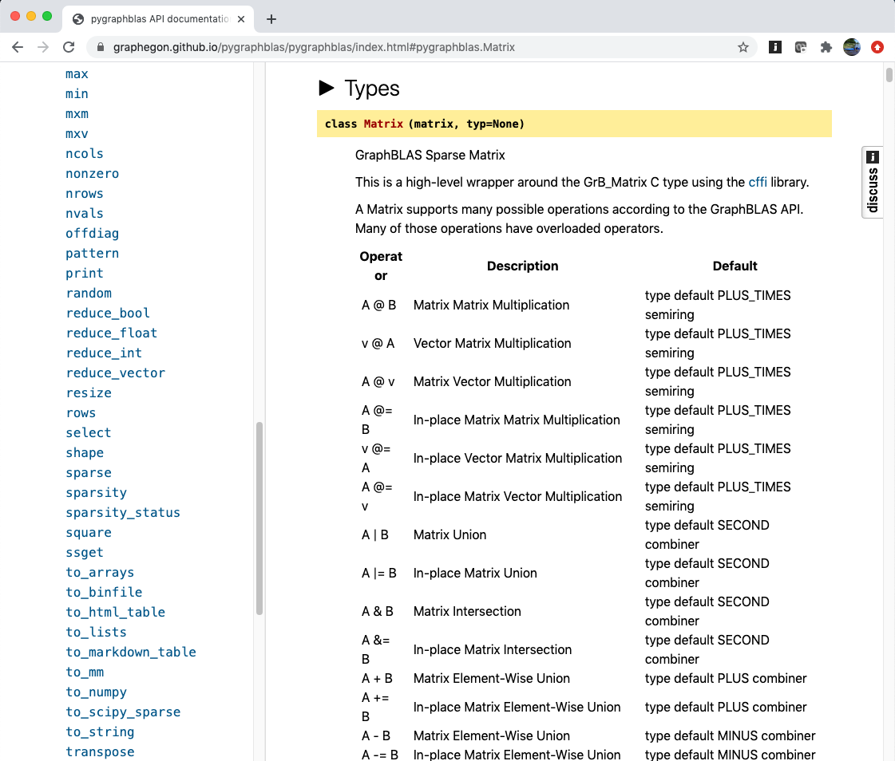

Slide 112
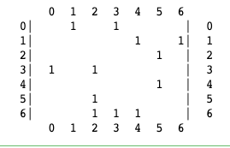
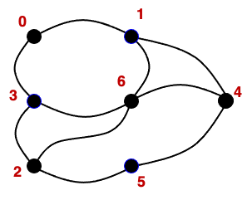
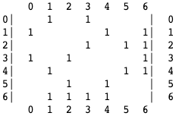
Exercise 12: Convert a directed graph into an undirected graph
The GraphBLAS “logo graph” you’ve been using since exercise 2 is a directed graph.
Look at the methods available with the Matrix type from the online pygraphblas documentation and write a python function to convert a directed graph into an unweighted, undirected graph of type uint64 with no self loops
https://graphegon.github.io/pygraphblas/pygraphblas/index.html
Notes:
GrB_Vector result, vec;
GrB_Index NODE;
GrB_Vector_new(&vec, GrB_BOOL, NUM_NODES);
GrB_Vector_setElement(vec, true, NODE);
pretty_print_vector_UINT64(vec, "Input node");
GrB_Descriptor desc;
GrB_Descriptor_new(&desc);
GrB_Descriptor_set(desc, FIELD, VALUE)
GrB_mxv(result, GrB_NULL, GrB_NULL,
GxB_LOR_LAND_BOOL, graph, vec, desc);

Slide 113
Exercise 12: Hint
Three steps:
Convert from input type to uint64 (but with the same pattern)
Remove self loops (i.e., the diagonal elements)
An undirected graph corresponds to a symmetric matrix. How do you take any matrix of values set to one (i.e., identify of uint64) and make it symmetric with values set to the identify of uint64? ← remember: you can control the operators used in GraphBLAS
https://graphegon.github.io/pygraphblas/pygraphblas/index.html
Note: The operation (directed-graph → undirected-graph) is used quite often.
For example, the weakly connected components (CCs) of a directed graph are the CCs of the undirected graph generated from the directed graph.
Notes:
GrB_Vector result, vec;
GrB_Index NODE;
GrB_Vector_new(&vec, GrB_BOOL, NUM_NODES);
GrB_Vector_setElement(vec, true, NODE);
pretty_print_vector_UINT64(vec, "Input node");
GrB_Descriptor desc;
GrB_Descriptor_new(&desc);
GrB_Descriptor_set(desc, FIELD, VALUE)
GrB_mxv(result, GrB_NULL, GrB_NULL,
GxB_LOR_LAND_BOOL, graph, vec, desc);

Slide 114
Exercise 12: Solution
def UndirUnweight(G):
G_unw = G.pattern(typ = grb.UINT64) # replace weights with UINT64 identity
G_nl = G_unw.offdiag() # make sure there are no self-loops
# make symmetric by adding (OR-ing) the matrix with its transpose
G_nl.eadd(G_nl, add_op=grb.types.UINT64.LOR, desc=grb.descriptor.T1,
out=G_nl)
return G_nl
Notes:
GrB_Vector result, vec;
GrB_Index NODE;
GrB_Vector_new(&vec, GrB_BOOL, NUM_NODES);
GrB_Vector_setElement(vec, true, NODE);
pretty_print_vector_UINT64(vec, "Input node");
GrB_Descriptor desc;
GrB_Descriptor_new(&desc);
GrB_Descriptor_set(desc, FIELD, VALUE)
GrB_mxv(result, GrB_NULL, GrB_NULL,
GxB_LOR_LAND_BOOL, graph, vec, desc);

Slide 115
Counting Triangles
Our goal is to count the number of triangles in an unweighted, undirected graph that has no self-edges.
Consider out undirected “logo” graph
There are two Triangles: (2,3,6) and (1,4,6)
Think of the problem in terms of hops over edges between vertices. In terms of hops, how would you define a triangle?

Slide 116
Counting Triangles
Our goal is to count the number of triangles in an unweighted, undirected graph that has no self-edges.
Consider out undirected “logo” graph
There are two Triangles: (2,3,6) and (1,4,6)
Think of the problem in terms of hops over edges between vertices. In terms of hops, how would you define a triangle?
A triangle occurs when a node is connected to another node in two ways:
A two-hop “wedge”,
A direct edge (i.e. one hop)

Slide 117
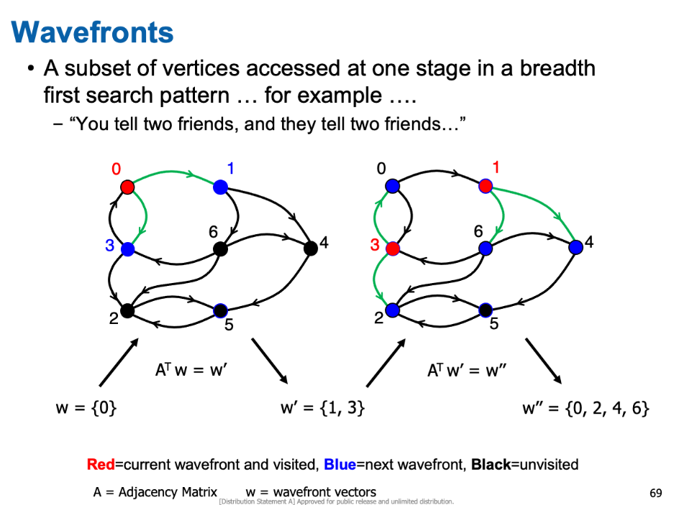
Finding wedges
How do we find all the “wedges” in a graph?
Or put in other terms … how do we find all the two hop paths between nodes in a Graph?
Remember in Exercise 8 … we learned to think of multiplication by an adjacency matrix as advancing a wavefront as you traverse a graph?
With this perspective on mxv, what does mxm for our undirected graph mean?

Slide 118
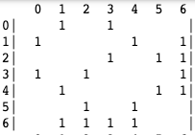
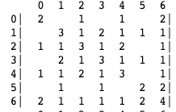
Matrix Multiplication
Matrix multiplication over our adjacency matrices … let’s look at the result for our undirected graph.
⊕.⊗
=
What does the product A ⊕.⊗ A = A² tell you?

Slide 119
Matrix Multiplication
Matrix multiplication over our adjacency matrices … let’s look at the result for our undirected graph.
⊕.⊗
=
What does the product A ⊕.⊗ A = A² tell you?
It tells you all the two hop paths between nodes in the graphs

Slide 120

Matrix Matrix multiplication: mxm()
$\text{C} ⨀$= A⊕.⊗B
The operators in GraphBLAS operations are:
Accumulator ⊙
Addition ⊕
Multiplication ⊗
The operators are implied by type.
Pygraphblas type | ⊙ | ⊕ | ⊗
types.BOOL | LOR | LOR | LAND
types.INT32 | 32 bit int add | 32 bit int add | 32 bit int multiply
types.FP32 | 32 bit float add | 32 bit float add | 32 bit float multiply
Pygraphblas gives you multiple ways to do matrix multplication
import pygraphblas as grb
# A, B and C are graphBLAS matrices defined elsewhere
D = A.mxm(B,mask=A) # creates a new D, uses A as a mask
A.mxm(B, semiring=grb.types.UINT64.PLUS_TIMES, out=C) # uses existing C
E = A@B # uses default semiring based on types and creates a new E
with(grb.types.UINT64.PLUS_TIMES):
F=A@A

Slide 121
From wedges to triangles
We now know how to find all the wedges.
How do we keep only the wedges that are part of a triangle?
There is more than one way to do this …. We leave it as an exercise for you to figure this out (hint: it uses GraphBLAS concepts we have already covered)
So after you solve that problem, you have a graphBLAS matrix with all the triangles. How do you count them?
Reduction to scalar: sum together all the elements of a matrix
Trimat.reduce_int(grb.types.UINT64.PLUS_MONOID)
The matrix that is being reduced
The name of the graphBLAS operation
The type and operator used in the reduction

Slide 122
Exercise 13: Counting Triangles
Write a function that will count the triangles in an undirected, unweighted graph that has no self-loops.
Use the graph you generated in Exercise 13.
Hints:
There are multiple ways to close wedges to find triangles. Think hard … we’ve shown you how to do this already.
Ask yourself … how many times are you counting each triangle? Is overcounting an issue?
https://graphegon.github.io/pygraphblas/pygraphblas/index.html
Notes:
GrB_Vector result, vec;
GrB_Index NODE;
GrB_Vector_new(&vec, GrB_BOOL, NUM_NODES);
GrB_Vector_setElement(vec, true, NODE);
pretty_print_vector_UINT64(vec, "Input node");
GrB_Descriptor desc;
GrB_Descriptor_new(&desc);
GrB_Descriptor_set(desc, FIELD, VALUE)
GrB_mxv(result, GrB_NULL, GrB_NULL,
GxB_LOR_LAND_BOOL, graph, vec, desc);

Slide 123
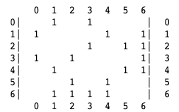
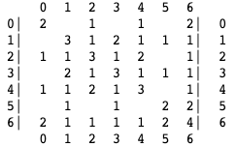
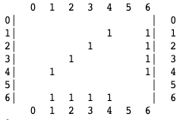
Exercise 13: First solution
2
inGraph =
1
def TriCount1(inGraph):
out = inGraph.mxm(inGraph,semiring=grb.types.UINT64.PLUS_TIMES)
tri = out.emult(inGraph)
red = tri.reduce_int(grb.types.UINT64.PLUS_MONOID)
return red/6
← Overcount by 6 … once for each vertex (3) in each direction (x2) for 6 total
out =
tri =
Counts of all the two-hop paths (wedges)
Keep wedges with an edge to close them
Notes:
GrB_Vector result, vec;
GrB_Index NODE;
GrB_Vector_new(&vec, GrB_BOOL, NUM_NODES);
GrB_Vector_setElement(vec, true, NODE);
pretty_print_vector_UINT64(vec, "Input node");
GrB_Descriptor desc;
GrB_Descriptor_new(&desc);
GrB_Descriptor_set(desc, FIELD, VALUE)
GrB_mxv(result, GrB_NULL, GrB_NULL,
GxB_LOR_LAND_BOOL, graph, vec, desc);

Slide 124

Exercise 13: Second solution
2
inGraph =
1
def TriCount2(inGraph):
out=inGraph.mxm(inGraph,semiring=grb.types.UINT64.PLUS_TIMES,mask=inGraph)
red=out.reduce_int(grb.types.UINT64.PLUS_MONOID)
return red/6
← Overcount by 6 … once for each vertex (3) in each direction (x2) for 6 total
out =
All the two-hop paths (wedges)
Only keep wedges with a closing edge in the original graph (using the mask)
Notes:
GrB_Vector result, vec;
GrB_Index NODE;
GrB_Vector_new(&vec, GrB_BOOL, NUM_NODES);
GrB_Vector_setElement(vec, true, NODE);
pretty_print_vector_UINT64(vec, "Input node");
GrB_Descriptor desc;
GrB_Descriptor_new(&desc);
GrB_Descriptor_set(desc, FIELD, VALUE)
GrB_mxv(result, GrB_NULL, GrB_NULL,
GxB_LOR_LAND_BOOL, graph, vec, desc);

Slide 125
Exercise 13: Third solution – work with lower triangular matrices only
def TriCount3(inGraph):
L = inGraph.tril(-1)
T = L.mxm(L, semiring=grb.types.UINT64.PLUS_TIMES, mask=L)
red = T.reduce_int(grb.types.UINT64.PLUS_MONOID)
return red
← Counts each triangle once (hi-mid-lo wedge closed by hi-lo edge)
1
2
3
4
5
6
1
2
3
4
5
6
1
2
3
4
5
6
1
2
3
4
5
6
1
1
1
1
1
1
1
1
1
1
1
1
1
1
)
1
1
1
1
1
1
1
1
1
1
1
1
1
1
(
2
1
1
1
1
1
1
2
1
1
1
1
1
1
∘
2
1
1
1
1
1
1
2
1
1
1
1
1
1
3
1
1
1
1
1
1
x
3
1
1
1
1
1
1
3
1
1
1
1
1
1
=
3
1
1
1
1
1
1
4
1
1
1
1
1
1
4
1
1
1
1
1
1
4
1
1
1
1
1
1
4
1
1
1
1
1
1
5
1
1
1
1
1
1
5
1
1
1
1
1
1
5
1
1
1
1
1
1
5
1
1
1
1
1
1
6
1
1
1
1
1
1
6
1
1
1
1
1
1
6
1
1
1
1
1
1
6
1
1
1
1
1
1
L
L
L
T
1
2
3
4
5
6
5
1
1
1
1
1
1
1
3
G
2
1
1
1
1
1
1
4
3
1
1
1
1
1
1
2
4
2
1
1
1
1
1
1
5
1
2
1
1
1
1
6
1
1
1
1
1
1
6
L²
Notes:
Restriction order: 2

Slide 126
Outline
Graphs and Linear Algebra
The GraphBLAS API and Adjacency Matrices
GraphBLAS Operations
Pygraphblas and modifying the behavior of operations.
Graph Algorithms expressed with GraphBLAS
Breadth-First Traversal
Connected Components
Triangle Counting
PageRank

Slide 127
PageRank
PageRank algorithm
Given a set of webpages (vertices), each page containing hyperlinks (edges) to other pages, the PageRank algorithm gives a measure of the importance of each page
The intuition is that (1) more important pages will receive more links from other pages and (2) links from more important pages count more than links from less important pages
This is an iterative algorithm that converges to a fixed-point
For this exercise, the graph will consist of directed edges, to simulate the unidirectional nature of hyperlinks
0
1
6
4
3
2
5

Slide 128

Exercise 14: PageRank iterative algorithm
Given an $N×N$ adjacency matrix $A$ and a damping factor $α$, compute the vector $r$ of page ranks of each vertex
Initially, all entries of $r$ have value $1/N$
At each iteration:
distribute the rank of a vertex among its neighbors (linked pages)
compute the new rank of a vertex as the sum of the contributions of all vertices that point to it (and a damping factor component)
if the old ranks and new ranks are close, end the computation
If $r[i]$ is the rank of vertex $i$, and $d[i]$ is the number of edges originating from vertex $i$ (out-degree of vertex $i$), then at each iteration we compute a new rank for each vertex $j$ as: $r\left[j\right]=\frac{1−α}{N}+\sum_{i∈A(:,j)}{r\left[i\right]⋅\frac{α}{d[i]}}$ where $A(:,j)$ are those vertices that have outgoing edges to vertex $j$

Slide 129
What you will create
import pygraphblas as grb
rowID = [0,0,1,1,2,3,3,4,5,6,6,6]
colID = [1,3,4,6,5,0,2,5,2,2,3,4]
vals = [True]*len(rowID)
A = grb.Matrix.from_lists(rowID, colID, vals)
r = pagerank(A)
print(r)
A
A
0 1 2 3 4 5 6
0| t t | 0
1| t t| 1
2| t | 2
3| t t | 3
4| t | 4
5| t | 5
6| t t t | 6
0 1 2 3 4 5 6
r
0|0.0429
1|0.0397
2|0.387
3|0.0505
4|0.0491
5|0.392
6|0.0383
➔
Notes:
src/Solutions/matvec.c
Todo: mention 1-hop in the explanation. This helps build to BFS. This is traversing edges backwards!

Slide 130
The pagerank function
def pagerank(A, damping = 0.85, tol = 1e-4, itermax = 100): ... <Your code here> ... return r
maximum iterations
convergence condition
damping factor
Notes:
src/Solutions/matvec.c
Todo: mention 1-hop in the explanation. This helps build to BFS. This is traversing edges backwards!

Slide 131
Preparing for the iterations
Number of vertices in graph: n = A.nrows
A vector of initial page ranks: r = grb.Vector.sparse(grb.types.FP32, n) r[:] = 1.0 / n
Computing the vector of out-degrees:
A
0 1 2 3 4 5 6
0| t t | 0
1| t t| 1
2| t | 2
3| t t | 3
4| t | 4
5| t | 5
6| t t t | 6
0 1 2 3 4 5 6
d
0| 2
1| 2
2| 1
3| 2
4| 1
5| 1
6| 3
A.reduce_vector(out=d, mon=grb.types.FP32.PLUS_MONOID)
➔

Slide 132


Inside the iterations
If we define a working vector $w$ such that $w\left[i\right]=r\left[i\right]⋅\frac{α}{d\left[i\right]}$ and reset $r\left[i\right]=\frac{1−α}{N}$ then we can update the page rank with a vector-matrix product $r=r+w⊕. ⊗A$
A
0 1 2 3 4 5 6
0| t t | 0
1| t t| 1
2| t | 2
3| t t | 3
4| t | 4
5| t | 5
6| t t t | 6
0 1 2 3 4 5 6
w
0| w[0]
1| w[1]
2| w[2]
3| w[3]
4| w[4]
5| w[5]
6| w[6]
0| w[3]
1| w[0]
2| w[3]+w[5]+w[6]
3| w[0]+w[6]
4| w[1]+w[6]
5| w[2]+w[4]
6| w[1]
$$⊕. ⊗$$
➔

Slide 133

Tips for inside the loop body
Save the current value of the $r$ vector so that you can compare later: t[:] = r[:] note – the colons are important to make a copy as opposed to just copying handles
Use element-wise operation to compute the vector $w$ (hint: you may want to pre-compute $α/d[i]$)
Use vector-matrix multiplication to compute $w⊕. ⊗A$ and accumulate with the reset value of vector $r$
Compute the absolute differences of all new ($r$) and old ($t$) values of the page rank of each vertex (hint: use element-wise operation and apply)
Use reduce_float to compute the sum of all absolute differences and compare with the convergence condition tol (but limit the maximum number of iterations to itermax)

Slide 134
vxm vs mxv
Name | Math | pygraphblas examples (import pygraphblas as grb)
mxv | r ⊙= A ⊕.⊗ w | mxv(self, other, cast=None, out=None, semiring=None, mask=None, accum=None, desc=None)
vxm | r^{T} ⊙= w^{T} ⊕.⊗ A | vxm(self, other, cast=None, out=None, semiring=None, mask=None, accum=None, desc=None)
w.vxm(A, out=r, accum=grb.types.FP32.PLUS, semiring=grb.types.FP32.PLUS_TIMES)

Slide 135
vxm vs mxv
Name | Math | pygraphblas examples (import pygraphblas as grb)
mxv | r ⊙= A ⊕.⊗ w | mxv(self, other, cast=None, out=None, semiring=None, mask=None, accum=None, desc=None)
vxm | r^{T} ⊙= w^{T} ⊕.⊗ A | vxm(self, other, cast=None, out=None, semiring=None, mask=None, accum=None, desc=None)
input vector
w.vxm(A, out=r, accum=grb.types.FP32.PLUS, semiring=grb.types.FP32.PLUS_TIMES)

Slide 136
vxm vs mxv
Name | Math | pygraphblas examples (import pygraphblas as grb)
mxv | r ⊙= A ⊕.⊗ w | mxv(self, other, cast=None, out=None, semiring=None, mask=None, accum=None, desc=None)
vxm | r^{T} ⊙= w^{T} ⊕.⊗ A | vxm(self, other, cast=None, out=None, semiring=None, mask=None, accum=None, desc=None)
input vector
input matrix
w.vxm(A, out=r, accum=grb.types.FP32.PLUS, semiring=grb.types.FP32.PLUS_TIMES)

Slide 137
vxm vs mxv
Name | Math | pygraphblas examples (import pygraphblas as grb)
mxv | r ⊙= A ⊕.⊗ w | mxv(self, other, cast=None, out=None, semiring=None, mask=None, accum=None, desc=None)
vxm | r^{T} ⊙= w^{T} ⊕.⊗ A | vxm(self, other, cast=None, out=None, semiring=None, mask=None, accum=None, desc=None)
input vector
input matrix
output vector
w.vxm(A, out=r, accum=grb.types.FP32.PLUS, semiring=grb.types.FP32.PLUS_TIMES)

Slide 138
vxm vs mxv
Name | Math | pygraphblas examples (import pygraphblas as grb)
mxv | r ⊙= A ⊕.⊗ w | mxv(self, other, cast=None, out=None, semiring=None, mask=None, accum=None, desc=None)
vxm | r^{T} ⊙= w^{T} ⊕.⊗ A | vxm(self, other, cast=None, out=None, semiring=None, mask=None, accum=None, desc=None)
input vector
input matrix
output vector
w.vxm(A, out=r, accum=grb.types.FP32.PLUS, semiring=grb.types.FP32.PLUS_TIMES)
arithmetic semiring

Slide 139
vxm vs mxv
Name | Math | pygraphblas examples (import pygraphblas as grb)
mxv | r ⊙= A ⊕.⊗ w | mxv(self, other, cast=None, out=None, semiring=None, mask=None, accum=None, desc=None)
vxm | r^{T} ⊙= w^{T} ⊕.⊗ A | vxm(self, other, cast=None, out=None, semiring=None, mask=None, accum=None, desc=None)
input vector
input matrix
output vector
add to present value of r
w.vxm(A, out=r, accum=grb.types.FP32.PLUS, semiring=grb.types.FP32.PLUS_TIMES)
arithmetic semiring

Slide 140
apply operation
Name | Math | pygraphblas examples (import pygraphblas as grb)
apply (vector) | u ⊙= f(v) | apply(self, op, out=None, mask=None, accum=None, desc=None)
apply (matrix) | C ⊙= f(A) | apply(self, op, out=None, mask=None, accum=None, desc=None)
input vector
t.apply(grb.types.FP32.ABS, out=t)

Slide 141
apply operation
Name | Math | pygraphblas examples (import pygraphblas as grb)
apply (vector) | u ⊙= f(v) | apply(self, op, out=None, mask=None, accum=None, desc=None)
apply (matrix) | C ⊙= f(A) | apply(self, op, out=None, mask=None, accum=None, desc=None)
input vector
t.apply(grb.types.FP32.ABS, out=t)
unary operator

Slide 142
apply operation
Name | Math | pygraphblas examples (import pygraphblas as grb)
apply (vector) | u ⊙= f(v) | apply(self, op, out=None, mask=None, accum=None, desc=None)
apply (matrix) | C ⊙= f(A) | apply(self, op, out=None, mask=None, accum=None, desc=None)
input vector
output vector
t.apply(grb.types.FP32.ABS, out=t)
unary operator

Slide 143
Exercise 14: Solution
def pagerank(A, damping = 0.85, tol = 1e-4, itermax = 100):
n = A.nrows
t = grb.Vector.dense(grb.types.FP32, n)
r = grb.Vector.dense(grb.types.FP32, n, fill = 1.0/n) # r[:]=1.0/n
d = grb.Vector.dense(grb.types.FP32, n, fill=damping) # d[:]=damping
A.reduce_vector(out=d, accum=grb.types.FP32.DIV, mon=grb.types.FP32.PLUS_MONOID)
for i in range(itermax):
t[:] = r[:]
w = t * d
r[:] = (1 - damping) / n
w.vxm(A, out=r, accum=grb.types.FP32.PLUS, semiring=grb.types.FP32.PLUS_TIMES)
# test for convergence
t = t - r
t.apply(grb.types.FP32.ABS, out=t)
rdiff = t.reduce_float(grb.types.FP32.PLUS_MONOID)
if rdiff <= tol:
break
return r
Notes:
src/Solutions/matvec.c
Todo: mention 1-hop in the explanation. This helps build to BFS. This is traversing edges backwards!

Slide 144
The GraphBLAS Operations of PageRank
We’ve expanded our repertoire of GraphBLAS operations
The same conventions are used across all operations so the operations we did not cover are straightforward to pick up

Slide 145
Conclusion and next steps
The GraphBLAS define a standard API for “Graph Algorithms in the Language of Linear Algebra”.
A wide range of algorithms are variations of the basic breadth first traversal for a graph.
To reach GraphBLAS mastery
Attend the Graph Architectures Programming and Learning (GrAPL) workshop at IPDPS
Attend GraphBLAS BoFs at HPEC and Supercomputing
Explore the challenge problems included with this tutorial
Work through the algorithms in the Graph book →

Slide 146
Appendices
MxM: the low-level details of the GraphBLAS operations
Common patterns for algorithmic reasoning
Challenge Problems:
Some key algorithms with the GraphBLAS
Reference materials

Slide 147
GraphBLAS: details of operations
When you read the GraphBLAS C API specification, the operations are described in a manner that may seem obtuse.
The definitions, however, are presented in this way for good reasons:
to cover the full range of variations exposed by the various arguments and to express the operation without ever specifying the undefined elements (i.e. the “zeros” of the semiring).
To avoid any reference to the non-stored elements of the sparse matrix. In sparse arrays, the undefined elements are usually assumed to be the ”zero of the semiring”. By defining the operations without any reference to those “un-stored values”, we can freely change the semirings between operations without having to update the un-stored elements.

Slide 148



GrB_mxm()
Matrix Multiplication … the way we learned it in school
Matrix Multiplication … set notation to ignore un-stored elements
With set notation, it’s easier to define the operations over a matrix as the semi-ring changes

Slide 149


GrB_mxm(): Function Signature

Slide 150
GrB_mxm(): Function Signature
GrB_Info return values:
GrB_SUCCESS | Blocking mode: Operations completed successfully. Nonblocking mode: consistency tests passed on dimensions and domains for input arguments
GrB_PANIC | Unknown Internal error
GrB_OUTOFMEM | Not enough memory for the operation
GrB_DIMENSION_MISMATCH | Matrix dimensions are incompatible.
GrB_DOMAIN_MISMATCH | Domains of matrices are incompatible with the domains of the accumulator, semiring, or mask.

Slide 151
Standard function behavior
Consider the following code:
GrB_Descriptor_new(&desc);
GrB_Descriptor_set(desc, GrB_OUTP, GrB_REPLACE);
GrB_Descriptor_set(desc, GrB_INP0, GrB_TRANS);
GrB_mxm(&C, M, Int32Add, Int32AddMul, A, B, desc);
int32AddMul semiring
int32Add accumulation
Form input operands and mask based on descriptor | C, B, M, A ← A^{T}
Test the domains and sizes for consistency. | int32, dims match
Carry out the indicated operation | T ← A *.+ B, Z ← C + T
Apply the write-mask to select output values | Z ← Z ∩ M
Replace mode: delete elements in output object and replace with output values | C ← Z
Merge mode: Assign output value (i,j) to element (i,j) of output object, but leave other elements of the output object alone.

Slide 152
MXM flowchart
To understand what happens inside a graphBLAS operation, consider matrix multiply.
All the operations follow this basic format
GrB_Info GrB_mxm(
GrB_Matrix C,
const GrB_Matrix M,
const GrB_BinaryOp accum,
const GrB_Semiring op,
const GrB_Matrix A,
const GrB_Matrix B,
const GrB_Descriptor desc);

Slide 153
Exercise: Matrix Matrix Multiplication
Multiply the adjacency matrix from our “logo graph” by itself.
Print resulting matrix and interpret the result
Hint: Do the multiply again and compare results. Do you see the pattern?
0
1
6
4
3
2
5

Slide 154
Appendices
MxM: the low-level details of the GraphBLAS operations
Common patterns for algorithmic reasoning
Challenge Problems:
Some key algorithms with the GraphBLAS
Reference materials

Slide 155
SpMSpV: Sparse-Matrix/Sparse-Vector Multiplication
2
SpMSpV: single-source graph traversal
Used in BFS, CC, matching, ordering, etc.
y = A.mxv(x, mask=p, desc=descriptor.T0)
A: sparse adjacency matrix
x: sparse input vector (previous frontier)
p: mask (already discovered vertices)
1
4
7
5
from
3
6
1
7
1
0
2
1
4
→
4
to
4
4
parents (p):
2
1
2
2
7
2
4
2
2
A^{T}
x
A^{T}x

Slide 156
SpMSpM: Sparse-Matrix/Sparse-Matrix Multiplication
SpGEMM: multi-source graph traversal
Ex: multi-source BFS, betweenness centrality, triangle counting*, Markov clustering*
Y=A.mxm(X, mask=P, desc=descriptor.T0)
A: sparse adjacency matrix
X: sparse input matrix (previous frontier), n-by-b where b is the #sources
P: mask (already discovered vertices), multi-vector version of p from previous slide
1
2
→
4
5
7
3
6
A^{T}
X
A^{T} • X
*: shown in later slides

Slide 157
SpMM: Sparse-Matrix/dense-Matrix Multiplication
SpMM: feature aggregation from neighbors
Used in Graph neural networks, graph embedding, etc.
W=A.mxm(H, desc=descriptor.T0)
A: sparse adjacency matrix, n-by-n
H: input dense matrix, n-by-f where f << n is the feature dimension
W: output dense matrix, new features
We call this dense matrix, H, a “tall skinny” Matrix
O(f) feature vector
3.2 5.4 … 1.3
v₆
3.2 5.4 … 1.3
…
…
…
…
…
v₁
W =
v₅
v₂
v₃
A^{T}
H
v₄

Slide 158
SpMSpM Example: Triangle Counting
Triangle counting is also multi-source(in fact, all sources) traversal.
It just stops after one traversal iteration only, discovering all wedges
B=L.mxm(U)
A
B, C
A = L + U (hi->lo + lo->hi)
L × U = B (wedge, low hinge)
A ∧ B = C (closed wedge)
sum(C)/2 = 4 triangles
3
3
1
4
5
4
5
2
1
6
6
1
2
1
2
A
L
U
C
1
1
1
2
1
2

Slide 159

SpMSpM Example: Triangle Counting
Markov clustering is also multi-source (in fact, all sources) traversal.
It alternates between SpGEMM and element-wise or column-wise pruning
C=A.mxm(A, desc=descriptor.T0T1)
A: sparse normalized adjacency matrix
C: denser (but still sparse) pre-pruned matrix for next iteration
Initial network
Iteration 1
Iteration 2
Iteration 3
At each iteration:
Step 1 (Expansion): Squaring the matrix while pruning (a) small entries, (b) denser columns
Naïve implementation: sparse matrix-matrix product (SpGEMM), followed by column-wise top-K selection and column-wise pruning
Step 2 (Inflation) : taking powers entry-wise
159

Slide 160
Appendices
MxM: the low-level details of the GraphBLAS operations
Common patterns for algorithmic reasoning
Challenge Problems:
Some key algorithms with the GraphBLAS
Reference materials

Slide 161
Challenge problems
Triangle counting
Direction optimizing Breadth first search
Betweenness Centrality

Slide 162

Notation
Notes:
op

Slide 163

Triangle Counting

Slide 164

Breadth First Search

Slide 165

Betweenness Centrality

Slide 166
Appendices
MxM: the low-level details of the GraphBLAS operations
Common patterns for algorithmic reasoning
Challenge Problems:
Some key algorithms with the GraphBLAS
Reference materials

Slide 167

Full set of GraphBLAS opaque objects

Slide 168

Error codes returned by GraphBLAS methods API Errors

Slide 169

Error codes returned by GraphBLAS methods Execution Errors

Slide 170
GraphBLAS predefined operators
A subset of operators from Table 2.3 of the GraphBLAS specification
Identifier | Domains | Description
GrB_LOR | bool x bool → bool | f(x,y) = x ∨ y | Logical OR
GrB_LAND | bool x bool → bool | f(x,y) = x ∧ y | Logical AND
GrB_EQ_T | T x T → bool | f(x,y) = (x==y) | Equal
GrB_MIN_T | T x T → T | f(x,y) =(x<y)?x:y | minimum
GrB_MAX_T | T x T → T | f(x,y) =(x>y)?x:y | maximum
GrB_PLUS_T | T x T → T | f(x,y) = x + y | addition
GrB_TIMES_T | T x T → T | f(x,y) = x * y | multiplication
GrB_FIRST_T | T x T → T | f(x,y) = x | First argument
GrB_SECOND_T | T x T → T | f(x,y) = y | Second argument
Where T is a suffix indicating type and includes FP32, FP64, INT32, UINT32, BOOL
Note: GrB_FIRST and GrB_SECOND are not commutative operators
This is a subset of the defined types and operators. See table 2.3 for the full list.

Slide 171
GraphBLAS Operations (a subset from the Math Spec*)
Name | Math | pygraphblas examples (import pygraphblas as grb)
mxm | C ⊙= A ⊕.⊗ B | mxm(self, other, cast=None, out=None, semiring=None, mask=None, accum=None, desc=None)
mxv | w ⊙= A ⊕.⊗ v | mxv(self, other, cast=None, out=None, semiring=None, mask=None, accum=None, desc=None)
vxm | w^{T} ⊙= v^{T} ⊕.⊗ A | vxm(self, other, cast=None, out=None, semiring=None, mask=None, accum=None, desc=None)
eWiseMult | C ⊙= A ⊗ B w ⊙= u ⊗ v | emult(self, other, mult_op=None, cast=None, out=None, mask=None, accum=None, desc=None) emult(self, other, mult_op=None, cast=None, out=None, mask=None, accum=None, desc=None)
eWiseAdd | C ⊙= A ⊕ B w ⊙= u ⊕ v | eadd(self, other, add_op=None, cast=None, out=None, mask=None, accum=None, desc=None) eadd(self, other, add_op=None, cast=None, out=None, mask=None, accum=None, desc=None)
reduce | w ⊙= ⊕_{j} A(:,j) | reduce_vector(self, mon=None, out=None, mask=None, accum=None, desc=None)
* Mathematical foundations of the GraphBLAS, Kepner et. al. HPEC’2016
Notes:
http://www.mit.edu/~kepner/GraphBLAS/GraphBLAS-Math-release.pdf

Slide 172
GraphBLAS Operations (a subset from the Math Spec*)
Name | Math | pygraphblas examples (import pygraphblas as grb)
mxm | C ⊙= A ⊕.⊗ B | A.mxm(B, out=C, accum=grb.INT64.PLUS) with Accum=grb.INT64.PLUS: C = A@B
mxv | w ⊙= A ⊕.⊗ v | with grb.INT64.PLUS_TIMES: w = A@v
vxm | w^{T} ⊙= v^{T} ⊕.⊗ A | w = v.vxm(A, mask=None, accum=grb.FP32.PLUS)
eWiseMult | C ⊙= A ⊗ B w ⊙= u ⊗ v | A.emult(B, out=C, accum=grb.INT32.PLUS) w=u*v
eWiseAdd | C ⊙= A ⊕ B w ⊙= u ⊕ v | C = A+B w=y.eadd(v, add_op=grb.FP64.DIV)
reduce | w ⊙= ⊕_{j} A(:,j) | A.reduce_vector(out=w, accum=grb.FP32.PLUS)
* Mathematical foundations of the GraphBLAS, Kepner et. al. HPEC’2016
Notes:
http://www.mit.edu/~kepner/GraphBLAS/GraphBLAS-Math-release.pdf

Slide 174
A Hands-On Introduction to GraphBLAS: The Python Edition (DAY 2) http://graphblas.org
≡
Scott McMillan
CMU/SEI
Tim Mattson
Intel Labs
… and the other members of the GraphBLAS specification group: Aydın Buluç (UC Berkeley/LBNL), Jose Moreira (IBM), and Ben Brock (UC Berkeley).
With a special thank you to Tim Davis (Texas A&M) for GraphBLAS support in SuiteSparse and Michel Pelletier (Graphegon) for creating pygraphblas.
To get course materials onto your laptop (updated README, slides):
$ git clone -b classroom21 https://github.com/GraphBLAS/SIAM-Tutorial.git

Slide 175
Reminders
To get course materials onto your laptop (updated README, slides):
$ git clone -b classroom21 https://github.com/GraphBLAS/SIAM-Tutorial.git
Reopen your tab from yesterday:
...
Your Docker container should now be ready at:
=====
http://graphblas.tk:98765/?token=1234567890abcdef1234567890abcdef1234567890abcdef
=====
****SAVE THIS URL!**** You will also need it for Day 2 of the tutorial.
If you do not see a URL, or there otherwise appears to be an error, please alert the tutorial staff.
Connection to graphblas.tk closed.
If you lost your URL, you can spin up a new server (code on next page):
$ ssh user@graphblas.tk
user@graphblas.tk's password: graphblastutorial2021
Documentation for pygraphblas (with lots of examples) can be found here:
https://graphegon.github.io/pygraphblas/pygraphblas/index.html

Slide 176
Where we left off: Solution to exercise 7: Finding one-hop out-neighbors
import pygraphblas as grb
rowID = [0,0,1,1,2,3,3,4,5,6,6,6]
colID = [1,3,4,6,5,0,2,5,2,2,3,4]
vals = [True]*len(rowID)
A = grb.Matrix.from_lists(rowID, colID, vals)
u = grb.Vector.sparse(grb.BOOL, A.nrows)
u[6] = True
with grb.BOOL.LOR_LAND:
# w = A.T @ u
w = A.mxv(u, desc = grb.descriptor.T0)
print(w)
A
A^{T}
0 1 2 3 4 5 6
0| t | 0
1| t | 1
2| t t t| 2
3| t t| 3
4| t t| 4
5| t t | 5
6| t | 6
0 1 2 3 4 5 6
u
0|
1|
2|
3|
4|
5|
6| t
w
0|
1|
2| t
3| t
4| t
5|
6|
@
➔
Notes:
src/Solutions/matvec.c
Todo: mention 1-hop in the explanation. This helps build to BFS. This is traversing edges backwards!

